Slide 1
L8 Autonomous Driving with IL&RL
Zonghua Gu 2021

Slide 2
RL Reward Function Issues
RL can be very effective, provided that a suitable reward function is available.
Bad reward function leads to undesirable behavior
Suppose you design a vacuum cleaner to maximize reward function defined as “cumulative amount of dirt sucked in”. The vacuum cleaner may learn to repeatedly spit out and suck in the same pile of dirt!
For AD in realistic environment, the goal is to reach destination with minimum time, while avoiding accidents. But how to encode this into a reward function?
“A great reward function can help you better optimize your reinforcement learning model. In AWS DeepRacer, the reward function is written in Python code, and uses different input parameters to help encourage good behavior and disincentivize poor behavior. There’s no single right answer for which parameters to include in your reward function, and your best reward function will likely require a lot of experimentation.” from AWS DeepRacer MOOC.
https://classroom.udacity.com/courses/ud014/
Notes:
State: Position of ego-car and environment (static and dynamic obstacles)
Action: Steering wheel/brake/accelerate

Slide 3
Imitation Learning (IL)
IL is useful when it is easier for an expert to demonstrate the desired behavior, rather than to specify a reward function for RL to learn the policy.
e.g., for Automated Driving in a realistic environment, the reward function would be a huge complex function involving everything in the environment
Requires access to an expert, either offline (driving data logs) or online (query-on-demand)
Also called Learning from Demonstrations.
IL variants:
Learn to mimic the expert’s policy
Behavior Cloning
Direct Policy Learning
Learn the expert’s value function
Inverse Reinforced Learning

Slide 4
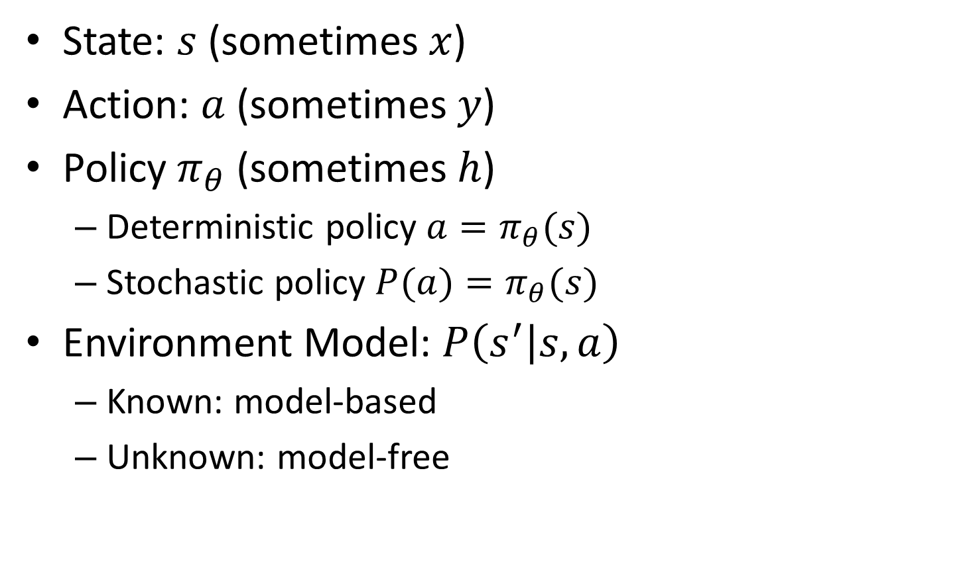
Notations
State: $s$ (sometimes $x$)
Action: $a$ (sometimes $y$)
Policy $π_{θ}$ (sometimes $h$)
Deterministic policy $a=π_{θ}(s)$
Stochastic policy $P(a)=π_{θ}(s)$
Environment Model: $P\left(s^{′} | s,a\right)$
Known: model-based
Unknown: model-free

Slide 5
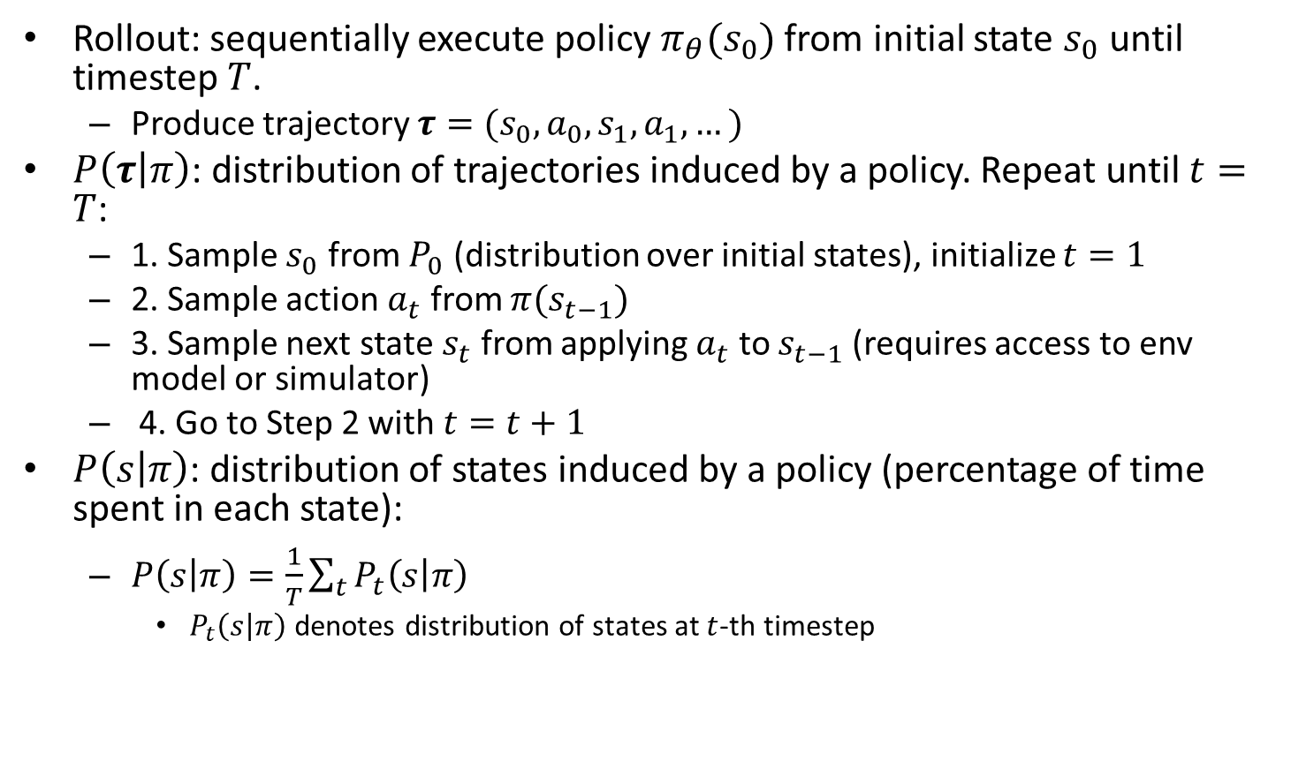
Notations Cont’d
Rollout: sequentially execute policy $π_{θ}(s_{0})$ from initial state $s_{0}$ until timestep $T$.
Produce trajectory $τ=(s_{0},a_{0},s_{1},a_{1},…)$
$P\left(τ | π\right)$: distribution of trajectories induced by a policy. Repeat until $t=T$:
1. Sample $s_{0}$ from $P_{0}$ (distribution over initial states), initialize $t=1$
2. Sample action $a_{t}$ from $π(s_{t−1})$
3. Sample next state $s_{t}$ from applying $a_{t}$ to $s_{t−1}$ (requires access to env model or simulator)
4. Go to Step 2 with $t=t+1$
$P\left(s | π\right)$: distribution of states induced by a policy (percentage of time spent in each state):
$P\left(s | π\right)=\frac{1}{T}\sum_{t}{P_{t}\left(s | π\right)}$
$P_{t}\left(s | π\right)$ denotes distribution of states at $t$-th timestep

Slide 6
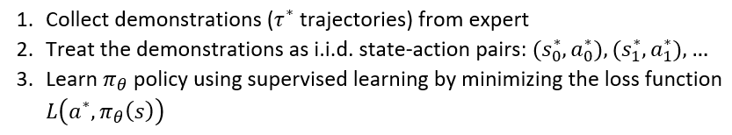
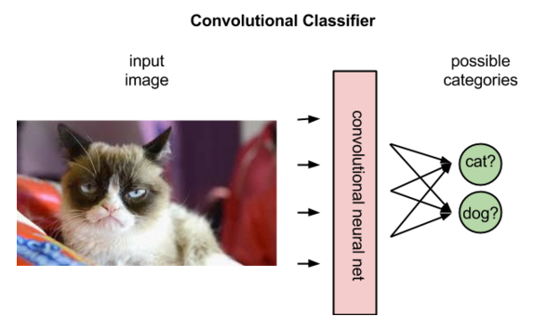
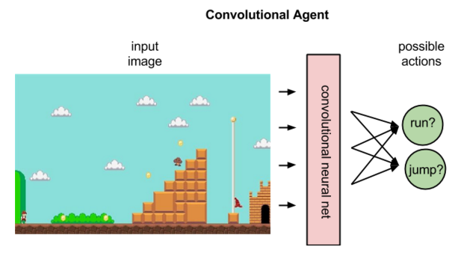
Behavior Cloning (BC)
Behavior Cloning (BC) is a form of Supervised Learning (SL), where an agent is trained to perform a task from demonstrations by learning a mapping (e.g., a CNN) between states (input data) and actions (labels).
https://pathmind.com/wiki/deep-reinforcement-learning

Slide 7
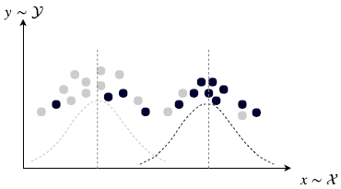
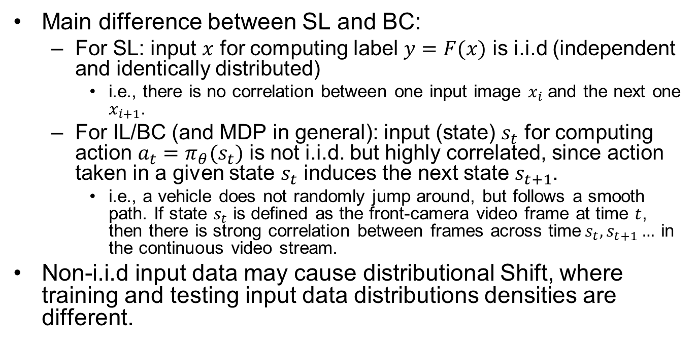
SL vs. BC
Main difference between SL and BC:
For SL: input $x$ for computing label $y=F(x)$ is i.i.d (independent and identically distributed)
i.e., there is no correlation between one input image $x_{i}$ and the next one $x_{i+1}$.
For IL/BC (and MDP in general): input (state) $s_{t}$ for computing action $a_{t}=π_{θ}(s_{t})$ is not i.i.d. but highly correlated, since action taken in a given state $s_{t}$ induces the next state $s_{t+1}$.
i.e., a vehicle does not randomly jump around, but follows a smooth path. If state $s_{t}$ is defined as the front-camera video frame at time $t$, then there is strong correlation between frames across time$s_{t},s_{t+1}…$ in the continuous video stream.
Non-i.i.d input data may cause distributional Shift, where training and testing input data distributions densities are different.
https://pathmind.com/wiki/deep-reinforcement-learning
Notes:
(sequence of state-action pairs)

Slide 8
Early Projects of IL (BC) Applied to AD
ALVINN
CMU, 1990
Low-res image as input
Fully connected NN
DAVE
Muller, LeCun, 2003
Low-res image as input
CNN

Slide 9
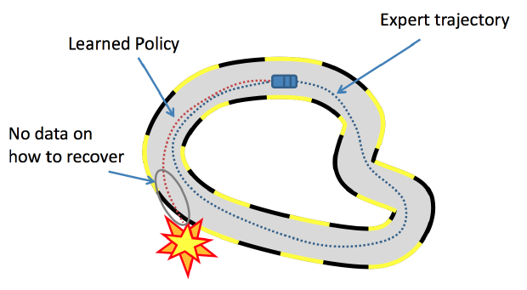
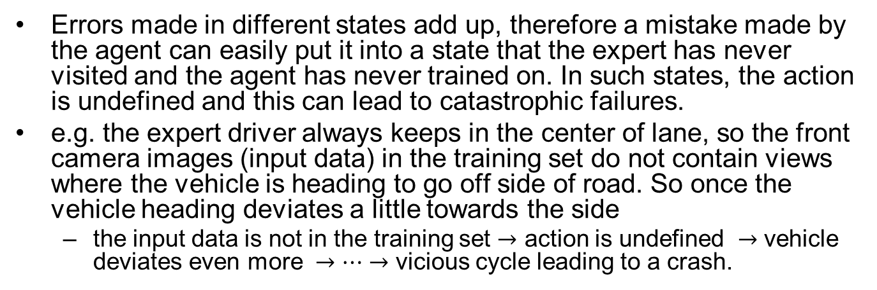
Distributional Shift in IL/BC
Errors made in different states add up, therefore a mistake made by the agent can easily put it into a state that the expert has never visited and the agent has never trained on. In such states, the action is undefined and this can lead to catastrophic failures.
e.g. the expert driver always keeps in the center of lane, so the front camera images (input data) in the training set do not contain views where the vehicle is heading to go off side of road. So once the vehicle heading deviates a little towards the side
the input data is not in the training set $→$ action is undefined $→$ vehicle deviates even more $→…→$ vicious cycle leading to a crash.
https://medium.com/@SmartLabAI/a-brief-overview-of-imitation-learning-8a8a75c44a9c

Slide 10
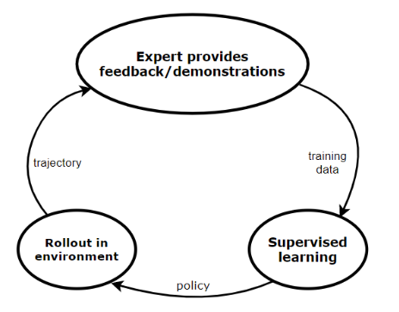
Direct Policy Learning (DPL)
DPL is an improved version of behavioral cloning. Assuming that we have access to an interactive expert at training time,
First, we start with an initial predictor policy based on the initial expert demonstrations.
Then, we execute a loop until we converge. In each iteration, we collect trajectories by rolling out the current policy (which we obtained in the previous iteration) and using these we estimate the state distribution.
Then, for every state, we collect feedback from the expert (what would have he done in the same state).
Finally, we train a new policy using this feedback.
Notes:
who we can query. Just like in BC, we collect some demonstrations from the expert, and we apply SL to learn a policy. We roll out this policy in our environment, and we query the expert to evaluate the roll-out trajectory. In this way, we get more training data, which we feedback to SL. This loop continues until we converge.

Slide 11
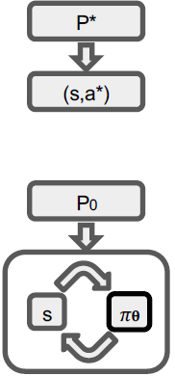
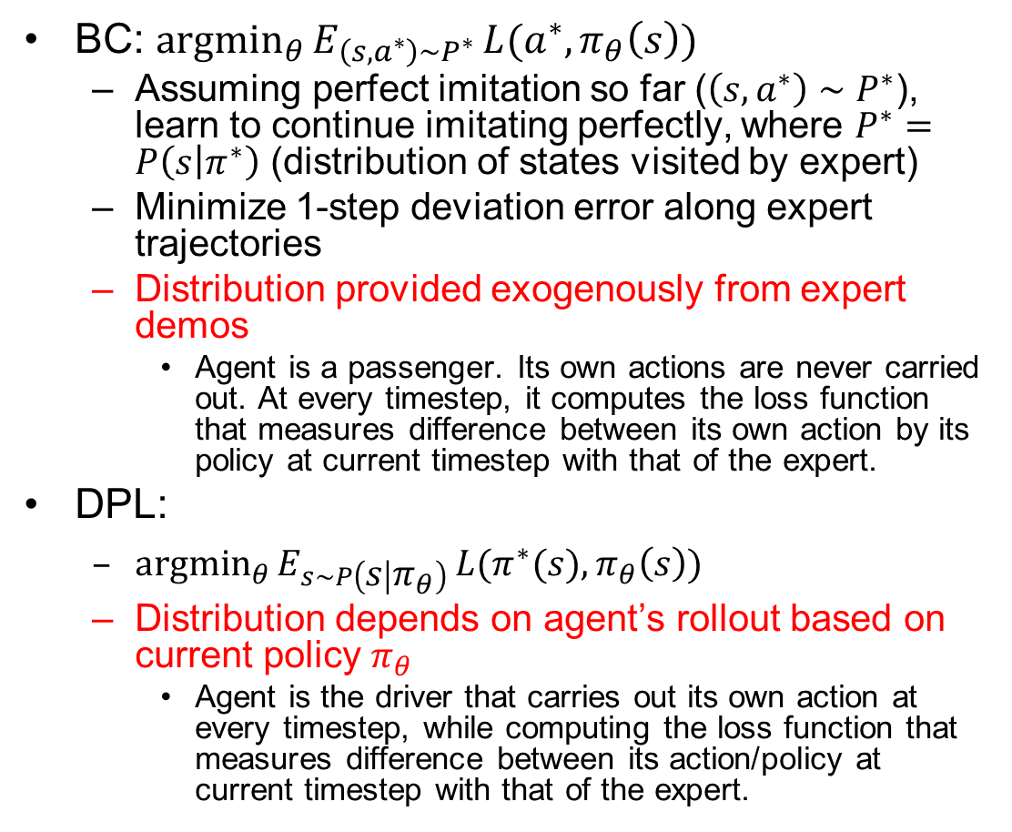
BC vs. DPL
BC: ${argmin}_{θ}{E_{\left(s,a^{∗}\right)∼P^{∗}}}L(a^{∗},π_{θ}\left(s\right))$
Assuming perfect imitation so far ($\left(s,a^{∗}\right)∼P^{∗}$), learn to continue imitating perfectly, where $P^{∗}=P\left(s | π^{∗}\right)$ (distribution of states visited by expert)
Minimize 1-step deviation error along expert trajectories
Distribution provided exogenously from expert demos
Agent is a passenger. Its own actions are never carried out. At every timestep, it computes the loss function that measures difference between its own action by its policy at current timestep with that of the expert.
DPL:
${argmin}_{θ}{E_{s∼P\left(s | π_{θ}\right)}}L(π^{∗}(s),π_{θ}\left(s\right))$
Distribution depends on agent’s rollout based on current policy $π_{θ}$
Agent is the driver that carries out its own action at every timestep, while computing the loss function that measures difference between its action/policy at current timestep with that of the expert.
Notes:
BC is off-policy learner (Q-learning) learns the value of the optimal policy independently of the agent's actions.
An on-policy learner learns the value of the policy being carried out by the agent including the exploration steps

Slide 12
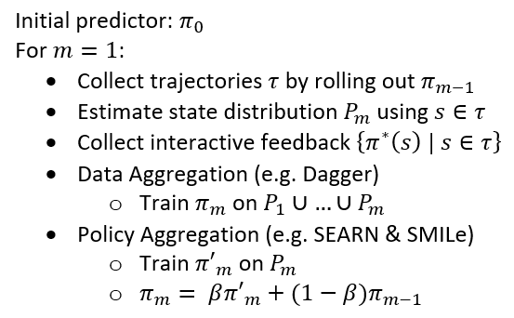
Two Variants of DPL
Data Aggregation trains the actual policy on all the previous training data.
e.g., Dagger: expert remains in the loop during the training of the controller: the controller is iteratively tested and samples from the obtained trajectories are re-labeled by the expert
Policy Aggregation trains a policy on the training data received on the last iteration and then combines this policy with all the previous policies using geometric blending. In the next iteration, we use this newly obtained, blended policy during the roll-out

Slide 13
Inverse Reinforcement Learning (IRL)
Start with a set of expert’s demonstrations (we assume these are optimal) and then try to estimate the parameterized reward function, that would cause the expert’s behavior/policy.
Problem: reward function is not unique, multiple reward functions may lead to the same behavior.
e.g., an outside observer sees that you work very hard (behavior). He may infer your reward function to be “maximize WorkTime” (since you really enjoy your job). But your actual reward function is “maximize MoneyEarned” (while you really hate your job).
An agent with incorrect value function won’t generalize well in a different environment. Suppose someone trains an agent to imitate you. The agent has the same behavior as you in the current environment, but faced with a job offer with higher salary, the agent may take a different action than you.
Solution: try to learn the correct value function by observing the expert in diverse environments.

Slide 14
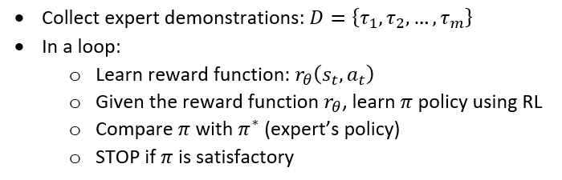
IRL Details
Repeat until we find a good enough policy:
Update the reward function parameters.
Solve the RL problem to find the optimal policy.
Compare the newly learned policy with the expert’s policy.

Slide 15
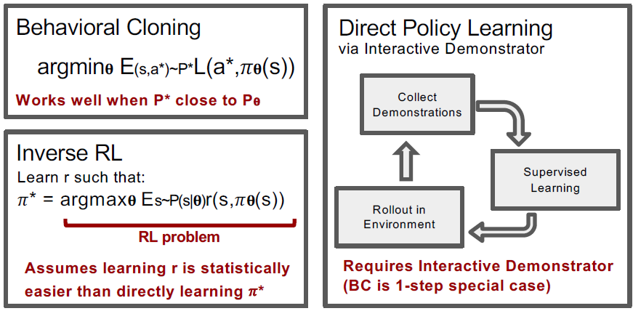
 | Learn Policy Directly | Learn Reward Function | Access to Env. | Interaction Demos | Pre-collected demos
BC | Y | N | N | N | Y
DPL | Y | N | Y | Y | Optional
IRL | N | Y | Y | N | Y
Notes:
Direct Policy
Learning
Reward
Learning
Access to
Environment
Interactive
Demonstrator
Pre-collected
Demonstrations

Slide 16
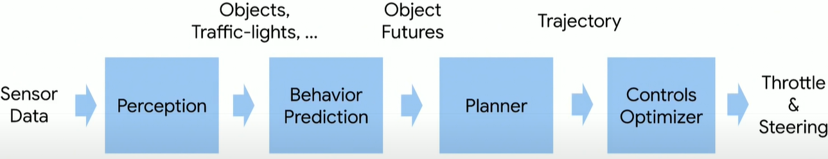
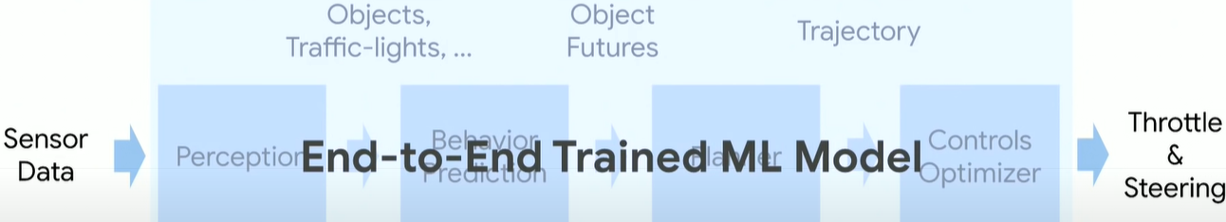
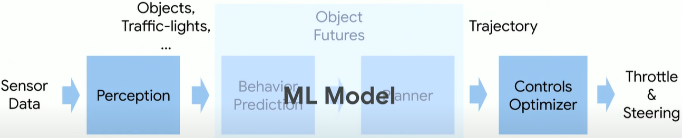
Classic Pipeline
End-to-End Driving (NVIDIA’s PilotNet)
Mid-to-Mid Driving (Waymo’s ChauffeurNet)

Slide 17
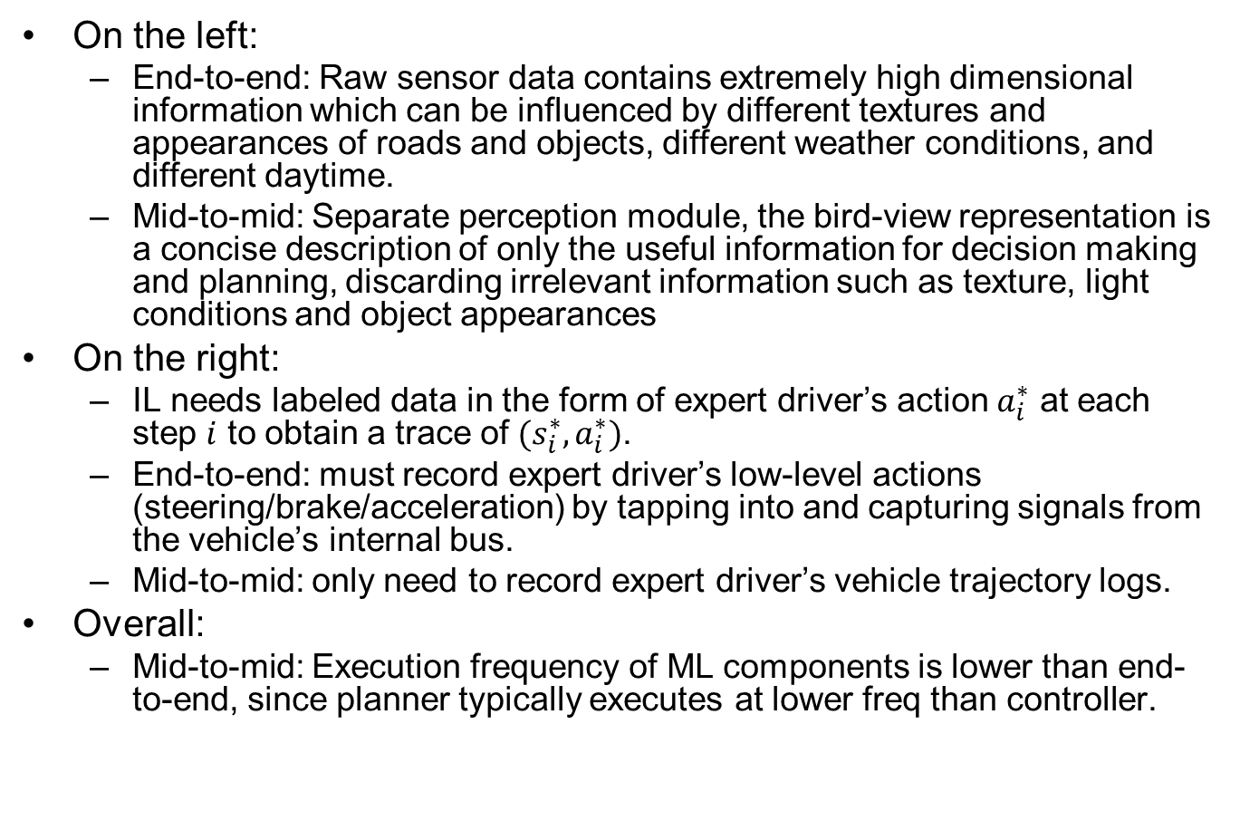
Advantages of Mid-to-Mid
On the left:
End-to-end: Raw sensor data contains extremely high dimensional information which can be influenced by different textures and appearances of roads and objects, different weather conditions, and different daytime.
Mid-to-mid: Separate perception module, the bird-view representation is a concise description of only the useful information for decision making and planning, discarding irrelevant information such as texture, light conditions and object appearances
On the right:
IL needs labeled data in the form of expert driver’s action $a_{i}^{∗}$ at each step $i$ to obtain a trace of $(s_{i}^{∗},a_{i}^{∗})$.
End-to-end: must record expert driver’s low-level actions (steering/brake/acceleration) by tapping into and capturing signals from the vehicle’s internal bus.
Mid-to-mid: only need to record expert driver’s vehicle trajectory logs.
Overall:
Mid-to-mid: Execution frequency of ML components is lower than end-to-end, since planner typically executes at lower freq than controller.
Notes:
generates bird-view representation, which helps simplify the visual information while maintaining useful information for driving.

Slide 18
[Zhou 2019]
Zhou, Brady, Philipp Krähenbühl, and Vladlen Koltun. "Does computer vision matter for action?." arXiv preprint arXiv:1905.12887 (2019). (Intel Labs, UT Austin)

Slide 19
Computer Vision vs. End-to-End
Computer vision tasks as perception module
Object recognition, depth estimation, optical flow, semantic segmentation…
e.g., train a model (CNN or others) with a large dataset to classify Stop Signs from images.
End-to-end approach
Map input images (raw pixels) directly to action, bypassing explicit computer vision tasks. Perceptual capabilities will arise as needed, as a result of training for the specific task.
e.g., if the training dataset is highway driving, then E2E model will never learn features of Stop Signs;
If the training dataset is urbane driving, then E2E model may learn features of Stop Signs implicitly in the intermediate layers of a CNN, during the process of learning the mapping from “Stop Sign” input images to “braking” action. But there is no explicit classification layer that outputs the label “StopSign”.
We report controlled experiments that assess whether specific vision capabilities are useful in mobile sensorimotor systems.
Does Computer Vision Matter for Action?
https://www.youtube.com/watch?v=4MfWa2yZ0Jc
Notes:
that act in complex 3D environments

Slide 20
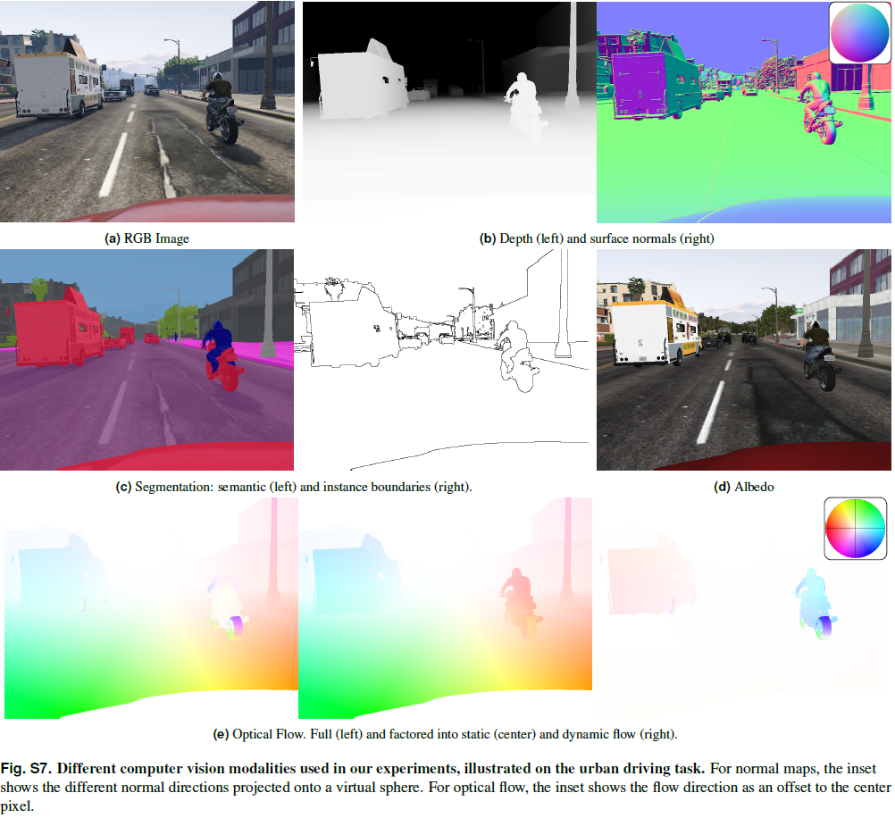

Slide 21
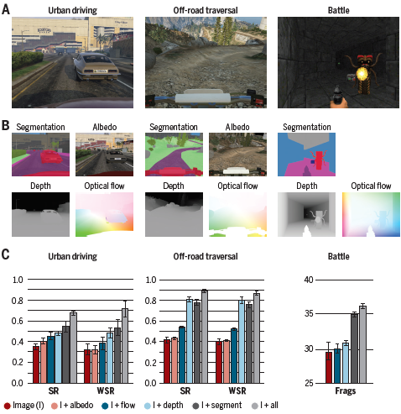
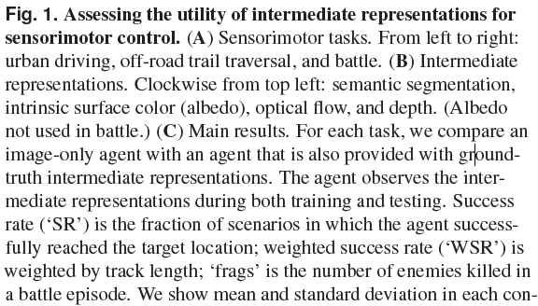
Performance Evaluation Results
Notes:
Surface albedo is defined as the ratio of radiosity to the irradiance (flux per unit area) received by a surface

Slide 22
Conclusions
Computer vision does matter.
When agents are provided with representations studied in computer vision, they achieve higher performance in sensorimotor tasks.
Some computer vision capabilities appear to be more impactful for mobile sensorimotor operation than others. Specifically, depth estimation and semantic segmentation provide the highest boost in task performance.
My thoughts: this explains rising popularity of mid-to-mid over end-to-end approaches.
Notes:
scene

Slide 23
PilotNet [Bojarski 2016]
Bojarski M, Del Testa D, Dworakowski D, et al. End to end learning for self-driving cars[J]. arXiv preprint arXiv:1604.07316, 2016.
End-to-End Driving (NVIDIA’s PilotNet)
Notes:
Bojarski M, Del Testa D, Dworakowski D, et al. End to end learning for self-driving cars[J]. arXiv preprint arXiv:1604.07316, 2016.
https://arxiv.org/abs/1604.07316

Slide 24
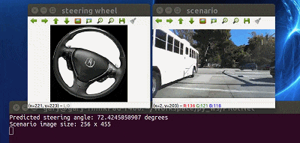
Training Method
End-to-End model trained with Imitation Learning (BC)
Human drives vehicle
Record sensor data and human actuator commands as training pairs
Train a DNN to map sensor data to actuator commands, mimicking a human. (PilotNet controls steering only. I think acceleration/braking are controlled separately, but the paper did not say how.)
PilotNet driving video:
https://www.youtube.com/watch?v=_N7nC-8YxzE
https://github.com/lhzlhz/PilotNet
Notes:
: End to End Learning for Self-Driving Cars

Slide 25
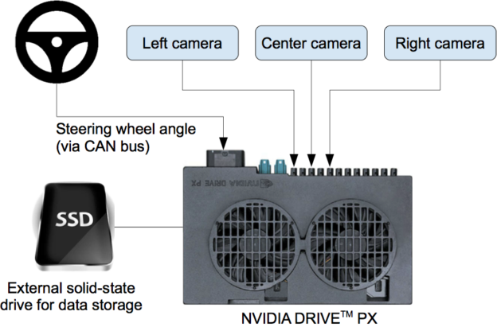
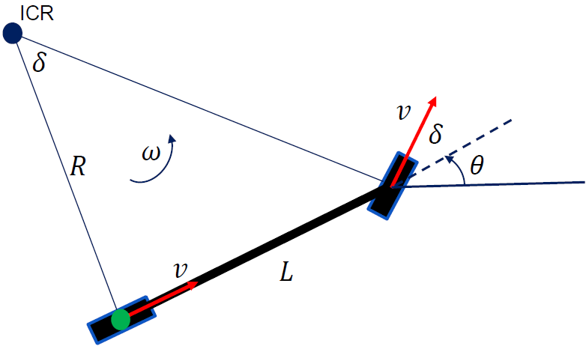
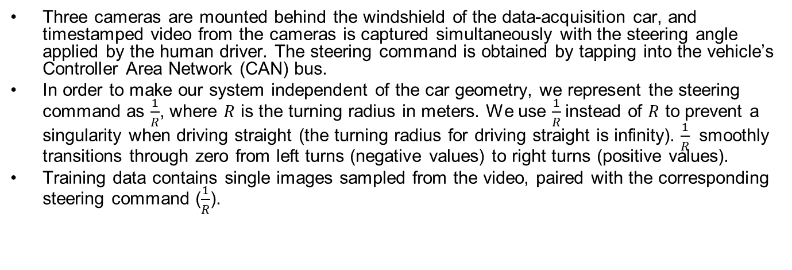
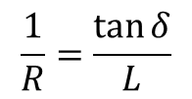
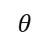
Data Collection System
Three cameras are mounted behind the windshield of the data-acquisition car, and timestamped video from the cameras is captured simultaneously with the steering angle applied by the human driver. The steering command is obtained by tapping into the vehicle’s Controller Area Network (CAN) bus.
In order to make our system independent of the car geometry, we represent the steering command as $\frac{1}{R}$, where $R$ is the turning radius in meters. We use $\frac{1}{R}$instead of $R$ to prevent a singularity when driving straight (the turning radius for driving straight is infinity). $\frac{1}{R}$ smoothly transitions through zero from left turns (negative values) to right turns (positive values).
Training data contains single images sampled from the video, paired with the corresponding steering command ($\frac{1}{R}$).
$$\frac{1}{R}=\frac{\tan{δ}}{L}$$
$$θ$$
https://devblogs.nvidia.com/deep-learning-self-driving-cars/

Slide 26
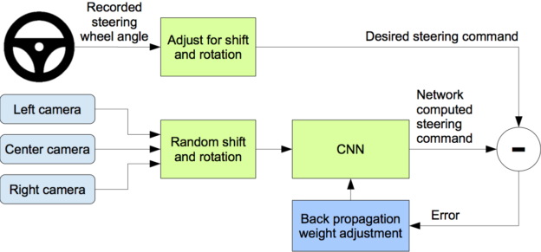
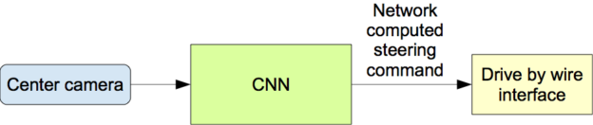
Training Data Augmentation
Problem: training data from human driver always stays in center of lane. So if car deviates from center, the image it sees is not in the training set, so it does not know the correct action.
Solution: Augment training data with additional images that show the car in different shifts from the center of the lane and rotations from the direction of the road. The images for two specific off-center shifts can be obtained from the left and the right cameras.
Training
Operation
Notes:
The training
data is therefore augmented with additional images that show the car in different shifts from the
center of the lane and rotations from the direction of the road.

Slide 27
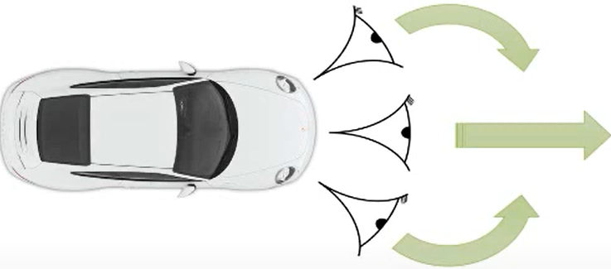
Training Data Augmentation Details
We augment the data by adding artificial shifts and rotations to teach the network how to recover from a poor position or orientation.
Images for two specific off-center shifts can be obtained from the left and the right camera. Additional shifts between the cameras and all rotations are simulated by viewpoint transformation of the image from the nearest camera. The steering label for transformed images is adjusted to one that would steer the vehicle back to the desired location and orientation in two seconds.
Ex.: Image from center camera shows car is driving straight; Shifted image from left camera shows car is leaning left. Associate this image with synthetic “turn right” command (even though human driver never issued it). During operation, if the center camera sees this image, issue “turn right” command.
Notes:
Precise viewpoint transformation requires 3D scene knowledge which we don’t have. We therefore approximate the transformation by assuming all points below
the horizon are on flat ground and all points above the horizon are infinitely far away. This works
fine for flat terrain but it introduces distortions for objects that stick above the ground, such as cars,
poles, trees, and buildings. Fortunately these distortions don’t pose a big problem for network training.

Slide 28
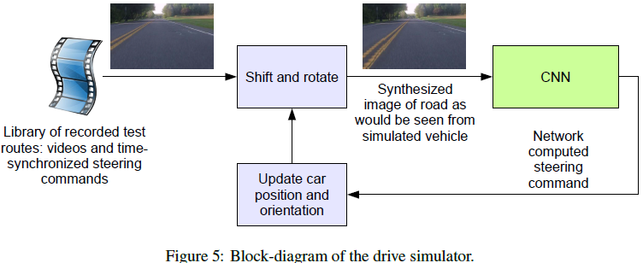
Driving Simulator
The simulator transforms the original images to account for departures from the ground truth. The magnitude of these perturbations is chosen randomly from a normal distribution.

Slide 29
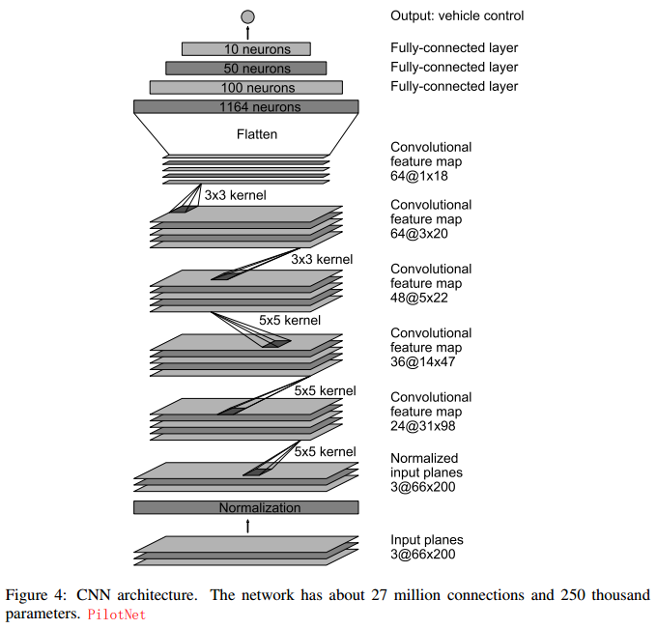
PilotNet
~250K distinct weights
~27M connections

Slide 30
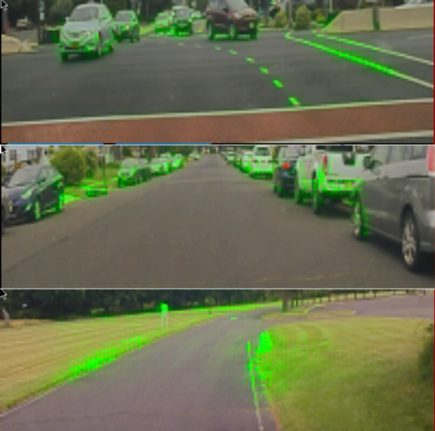
Visualization of Salient Objects
The visualization shows which regions of the input image contribute most to the output of the network. These regions identify the salient objects (highlighted in green).
PilotNet focuses on the same things a human driver would, including lane markers, road edges and other cars.
https://blogs.nvidia.com/blog/2017/04/27/how-nvidias-neural-net-makes-decisions/
Bojarski M, Yeres P, Choromanska A, et al. Explaining how a deep neural network trained with end-to-end learning steers a car[J]. arXiv preprint arXiv:1704.07911, 2017.
Notes:
Visualization, overlaid on an image of what the car’s camera recorded. Everything in green is a high priority focus point for the network.

Slide 31
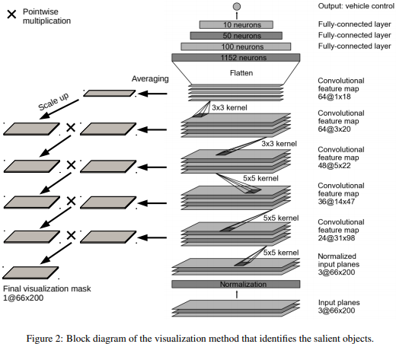
Visualization Method
Not covered in exam

Slide 32
On-Road Tests
After a trained network has demonstrated good performance in the simulator, the network is loaded on the DRIVE PX in our test car and taken out for a road test.
For a typical drive in Monmouth County NJ from our office in Holmdel to Atlantic Highlands, we are autonomous approximately 98% of the time. We also drove 10 miles on the Garden State Parkway (a multi-lane divided highway with on and off ramps) with zero intercepts.
Notes:
For these tests we measure performance
as the fraction of time during which the car performs autonomous steering. This time
excludes lane changes and turns from one road to another.

Slide 33
Chauffeurnet [Bansal 2018]
Bansal M, Krizhevsky A, Ogale A. Chauffeurnet: Learning to drive by imitating the best and synthesizing the worst[J]. arXiv preprint arXiv:1812.03079, 2018.
Mid-to-Mid Driving (Waymo’s ChauffeurNet)
https://medium.com/waymo/learning-to-drive-beyond-pure-imitation-465499f8bcb2
Notes:
Learning to Drive: Beyond Pure Imitation
Waymo Team, 2018 Bansal, Mayank, Alex Krizhevsky, and Abhijit Ogale. "Chauffeurnet: Learning to drive by imitating the best and synthesizing the worst." arXiv preprint arXiv:1812.03079 (2018). https://arxiv.org/pdf/1812.03079.pdf

Slide 34
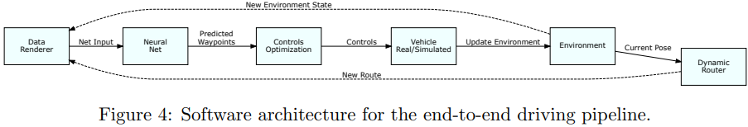
Abstract
Our goal is to train a policy for autonomous driving via imitation learning that is robust enough to drive a real vehicle. We find that standard behavior cloning is insufficient for handling complex driving scenarios, even when we leverage a perception system for preprocessing the input and a controller for executing the output on the car: 30 million examples are still not enough.
Training data: 30 million real-world expert driving examples, corresponding to about 60 days of continual driving
We propose exposing the learner to synthesized data in the form of perturbations to the expert’s driving, which creates interesting situations such as collisions and/or going off the road.
Rather than purely imitating all data, we augment the imitation loss with additional losses that penalize undesirable events and encourage progress – the perturbations then provide an important signal for these losses and lead to robustness of the learned model.

Slide 35
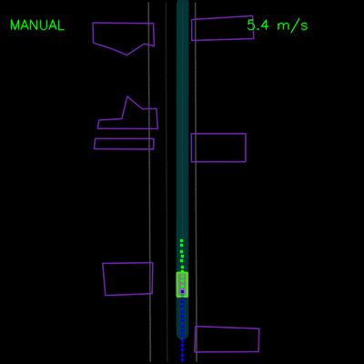
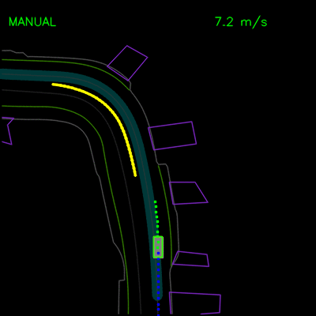
BC Experiments
Agent trained with pure BC gets stuck behind a parked vehicle (left) and is unable to recover from a trajectory deviation while driving along a curved road (right). The teal path depicts the input route, yellow box is a dynamic object in the scene, green box is the agent, blue dots are the agent’s past positions and green dots are the predicted future positions.

Slide 36


ChauffeurNet Experiments
ChauffeurNet model can now successfully nudge around the parked vehicle (left) and recover from the trajectory deviation to continue smoothly along the curved road (right).

Slide 37
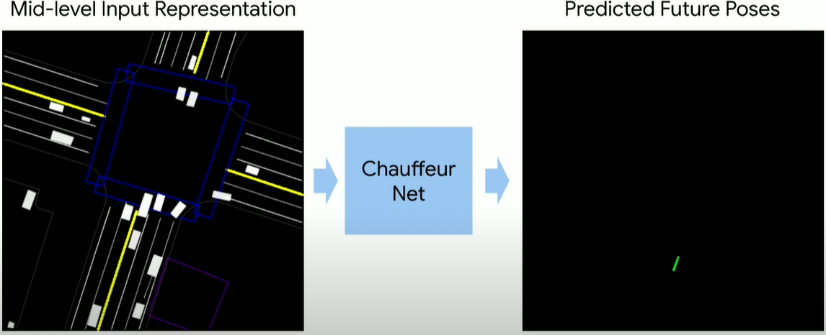
ChauffeurNet Input/Output
We use a perception system that processes raw sensor information and produces our input: a top-down representation of the environment and intended route, where objects such as vehicles are drawn as oriented 2D boxes along with a rendering of the road information and traffic light states. We present this mid-level input to a recurrent neural network (RNN), named ChauffeurNet, which then outputs a driving trajectory that is consumed by a controller which translates it to steering and acceleration.

Slide 38
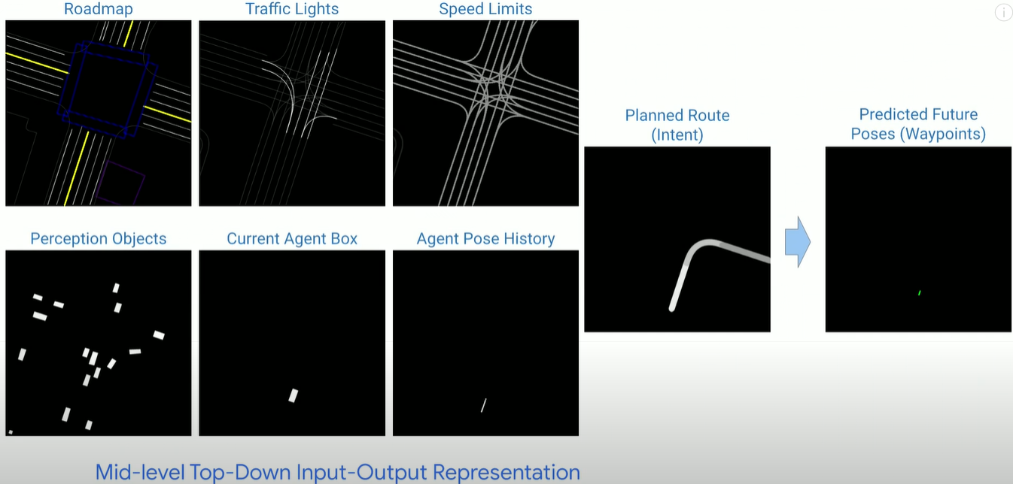
ChauffeurNet Input/Output in Detail

Slide 39
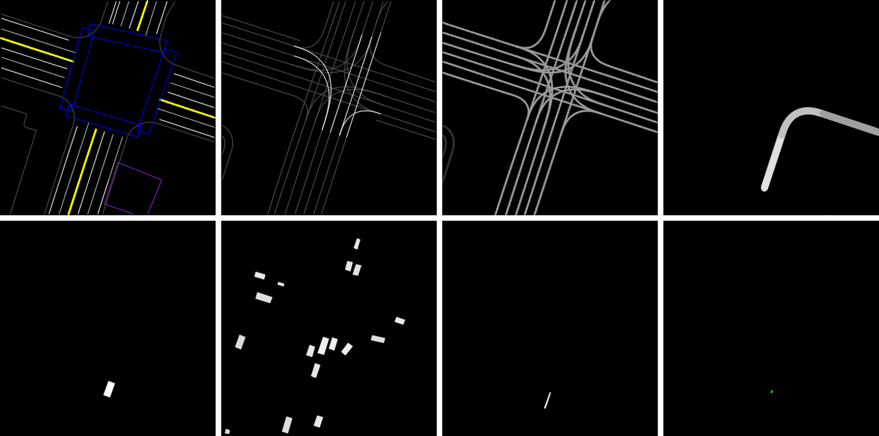
Rendered inputs and outputs
Output
Top-row left-to-right: Roadmap, Traffic lights (bright lines denote red light), Speed-limit, and Planned Route (intent: ego-car should turn right).
Bottom-row left-to-right: Current Agent Box, Dynamic Boxes (history of past 1-2s), Past Agent Poses, and the output Future Agent Poses (shown in last slide).

Slide 40
ChauffeurNet Architecture
ChauffeurNet is a Convolutional Recurrent Neural Network (RNN), consisting of the CNN FeatureNet, and the AgentRNN.
Trained with IL, guided by ground truth data (green) and loss functions (blue)
26M examples from real driving logs
Compare to PilotNet
PilotNet uses CNN to map from current camera image to steering angle, no history info is use.
ChauffeurNet uses RNN, and exploits the history (past agent location and past prediction for a few seconds) to make better predictions and decisions.

Slide 41
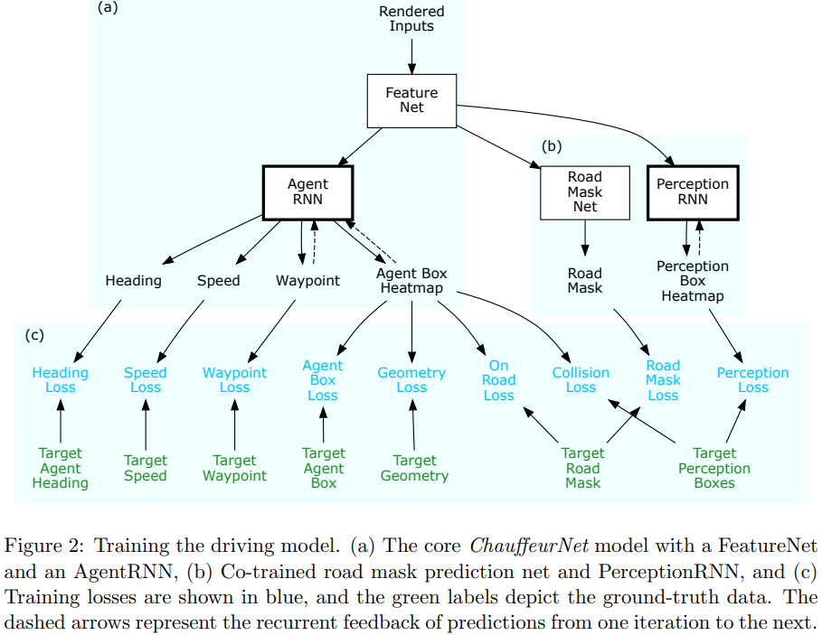
Not covered in exam

Slide 42
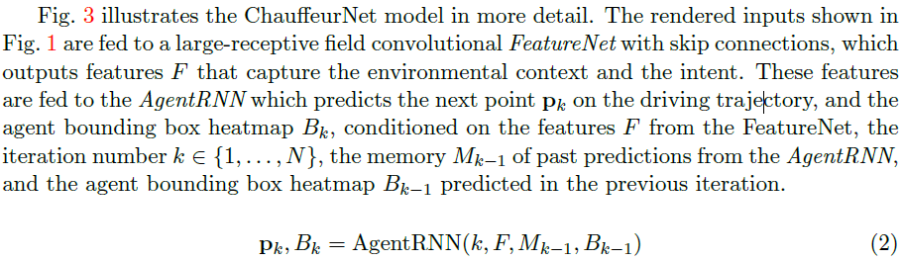
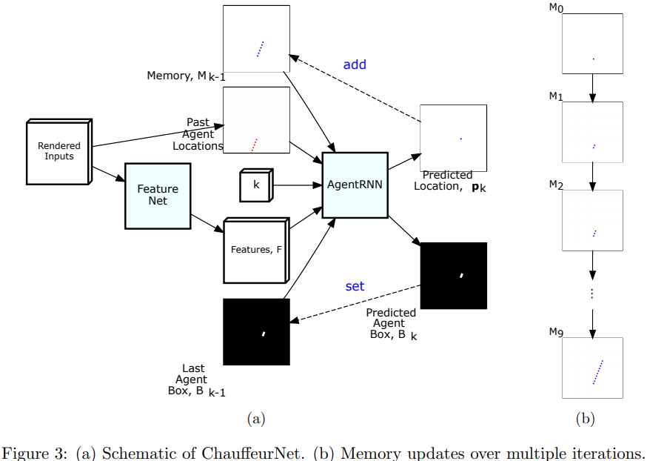
ChauffeurNet Details
Not covered in exam
Notes:
The AgentRNN consumes
1) an image with a rendering of the past agent poses,
2) a set of features computed by a convolutional network “FeatureNet” from the rendered inputs,
3) an image with the last agent box rendering,
4) an explicit memory with a rendering of the predicted future agent poses to predict the next agent pose and the next agent box in the top-down view. (memory is not learned but hand-crafted)
These predictions are used to update the inputs to the AgentRNN for predicting the next timestep
Each iteration predicts the next waypoint conditioned on all previously predicted waypoints and input data.

Slide 43
Beyond Pure Imitation
Synthesizing Perturbations
Beyond the Imitation Loss
Collision Loss
On Road Loss
Geometry Loss
Auxiliary Losses
Imitation Dropout

Slide 44
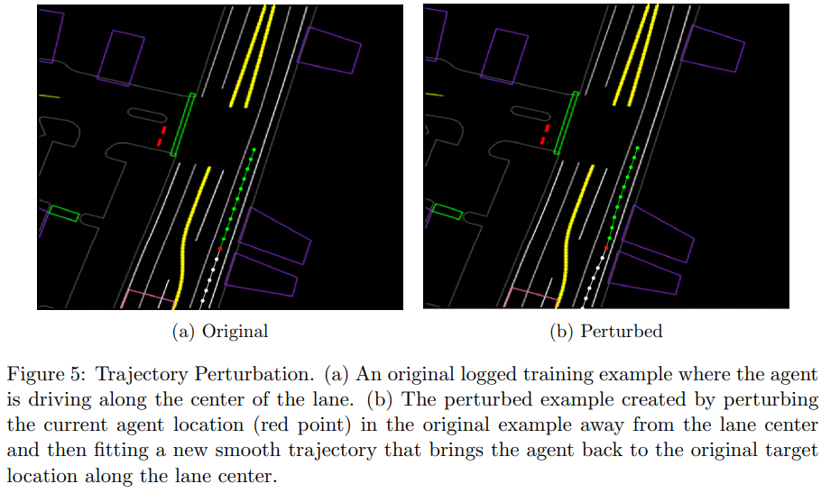
Trajectory Perturbation
Running the model as a part of a closed-loop system over time can cause the input data to deviate from the training distribution. To prevent this, we train the model by adding some examples with realistic perturbations to the agent trajectories.
Notes:
Domain Randomization w.
Randomized heading offsetsThe start and end of a trajectory are kept constant, while a perturbation is applied around the midpoint and smoothed across the other points. Quantitatively, we jitter the midpoint pose of the agent uniformly at random in the range [−0.5, 0.5] meters in both axes, and perturb the heading by [−π/3, π/3] radians. We then fit a smooth trajectory to the perturbed point and the original start and end points. Such training examples bring the car back to its original trajectory after a perturbation.

Slide 45
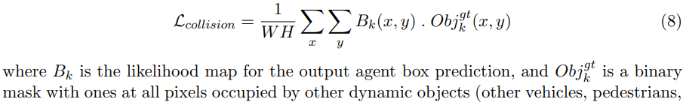
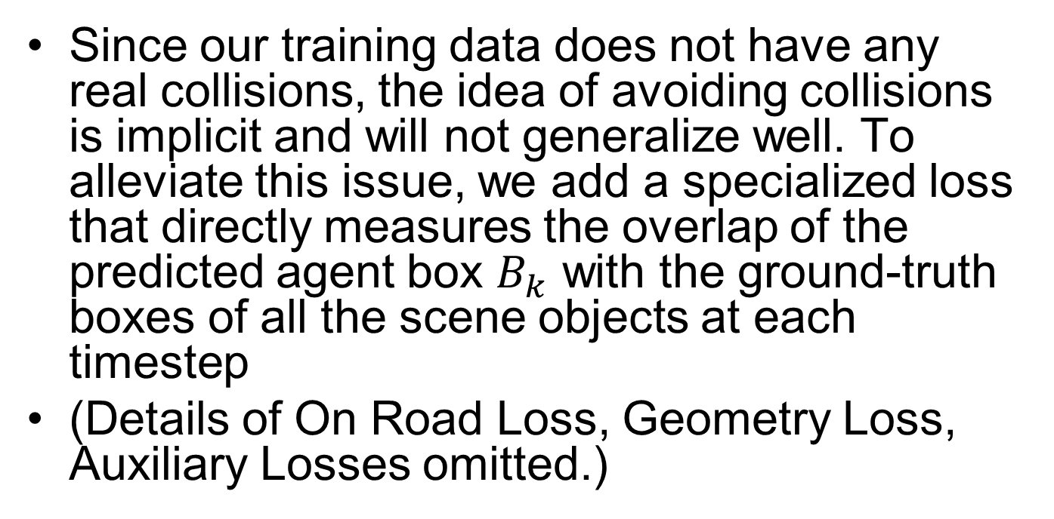
Collision Loss
Since our training data does not have any real collisions, the idea of avoiding collisions is implicit and will not generalize well. To alleviate this issue, we add a specialized loss that directly measures the overlap of the predicted agent box $B_{k}$ with the ground-truth boxes of all the scene objects at each timestep
(Details of On Road Loss, Geometry Loss, Auxiliary Losses omitted.)

Slide 46
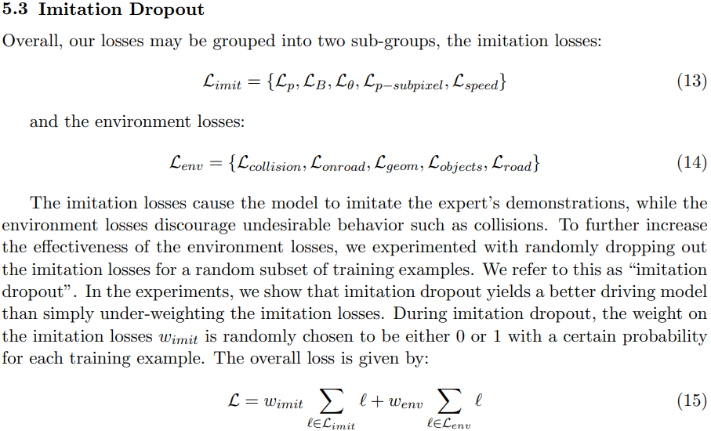
Imitation Dropout
Not covered in exam

Slide 47
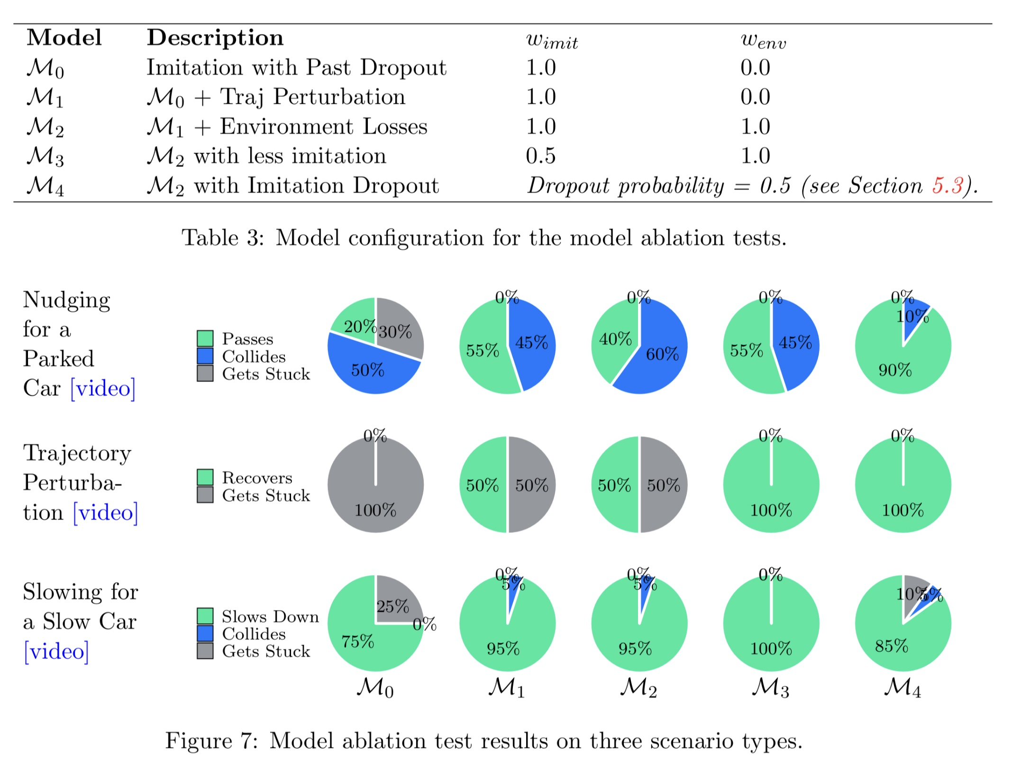

Slide 48
IL with Safety [Chen 2019]
Chen J, Yuan B, Tomizuka M. Deep imitation learning for autonomous driving in generic urban scenarios with enhanced safety[J]. arXiv preprint arXiv:1903.00640, 2019.

Slide 49
Abstract
The decision and planning system for AD in urban environments is hard to design. Most current methods are to manually design the driving policy, which can be sub-optimal and expensive to develop and maintain at scale. Instead, with imitation learning we only need to collect data and then the computer will learn and improve the driving policy automatically. However, existing imitation learning methods for autonomous driving are hardly performing well for complex urban scenarios. Moreover, the safety is not guaranteed when we use a DNN policy. In this paper, we proposed a framework to learn the driving policy in urban scenarios efficiently given offline collected driving data, with a safety controller incorporated to guarantee safety at test time. The experiments show that our method can achieve high performance in realistic three-dimensional simulations of urban driving scenarios, with only hours of data collection and training on a single consumer GPU.

Slide 50
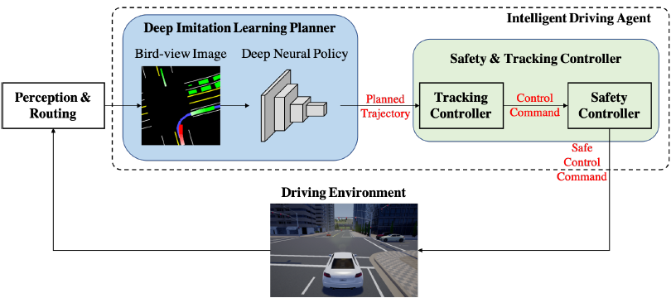
Framework Overview
The agent takes information from the perception and routing modules, generates a bird-view image and outputs the planned trajectory using a DNN policy network. The safety & tracking controller then calculates the safe control command to be applied to the ego vehicle in the driving environment
Notes:
The deep imitation learning trajectory
planner is responsible to handle almost everything about driving
intelligence, such as how to follow the given routing in
various road conditions, how to react to surrounding objects,
and how to handle different traffic light states. This module is
learned end-to-end from the perception results to the planned
trajectory. The safety & tracking controller is responsible to
guarantee safety and handle vehicle dynamics.

Slide 51


Deep Imitation Learning
DNN output is future trajectory in a preview horizon $H$: $[x_{t+1},y_{t+1},…,x_{t+H},y_{t+H}]$, which is tracked by a low-level controller (PID, MPC).
Notes:
To make the learned policy generalize well, the dataset needs to cover enough data for each dimension of sensor information such as texture, weather, light conditions and object appearances.

Slide 52

DNN Architecture & Loss Function
Based on CNN (VGGNet16). Output layer has $H$units corresponding to $H$ predicted trajectory points $\left({\hat{x}}_{t+i}, {\hat{y}}_{t+i}\right), i∈[1,H]$.
Loss function to be minimized:
$L_{t}=\frac{1}{H}\sum_{i=1}^{H}{d_{t+i}^{2}}$
where displacement error $d_{t+i}$ between the expert’s motion trajectory point position $(x_{t+i}, y_{t+i})$ and the predicted point position $({\hat{x}}_{t+i}, {\hat{y}}_{t+i})$: $d_{t+i}={\left({\left(x_{t+i}−{\hat{x}}_{t+i}\right)}^{2}+{\left(y_{t+i}−{\hat{y}}_{t+i}\right)}^{2}\right)}^{\frac{1}{2}}$
Notes:
in The overall loss function is defined as
(vs. ConvRNN in ChauffeurNet)
the ego vehicle local coordinate

Slide 53
Data Collection and Augmentation
Based on CARLA simulator.
At data collection phase, we use a model-based controller to act as the expert. The controller is same as other agents, which performs normal urban driving behaviors and make random turns at intersections. When ego vehicle is running, we record the rendered bird-view images and the corresponding ego vehicle states (global positions and yaw angle) every 0.1 second.
We introduce control noise to the expert controller during the data collection phase, and let the expert recover from the perturbation. The control noise is added periodically every 8 seconds, and will last for 1 second. The vehicle’s pose might be pushed away from the way points. The expert then provides demonstrations of recovering from perturbations. The states during the noise phase are removed in order not to contaminate the dataset

Slide 54

Trajectory Tracking Controller
Given the planned future trajectory $[{\hat{x}}_{t+1},{\hat{y}}_{t+1},…,{\hat{x}}_{t+H},{\hat{y}}_{t+H}]$, the tracking controller outputs the desired acceleration $a_{t}$ and steering angle $δ_{t}$ to drive the vehicle to follow the trajectory. A way point $({\hat{x}}_{t+m},{\hat{y}}_{t+m})$ is selected with $m∈[1,H−1]$ (we pick $m=5$ here).
At any time instant $t$, aim for the 5th point $({\hat{x}}_{t+5},{\hat{y}}_{t+5})$ on the planned trajectory
Decomposed into longitudinal controller and lateral controller, both PID controllers.

Slide 55

Longitudinal Controller
Not covered in exam
Target speed is set to be:
$v_{d}=\frac{1}{dt}{\left\|\left({\hat{x}}_{t+m+1},{\hat{y}}_{t+m+1}\right)−\left({\hat{x}}_{t+m},{\hat{y}}_{t+m}\right)\right\|}_{2}$
Where $dt$ is the time interval between two subsequent time steps.
The desired acceleration is obtained using PID control to minimize speed tracking error
$e_{v}\left(t\right)=v_{d}−v(t)$
where $v(t)$ is current speed of ego vehicle.

Slide 56


Lateral Controller
Not covered in exam
The normal vector from the ego vehicle position to the target way point is
$n_{target}=\frac{\left({\hat{x}}_{t+m},{\hat{y}}_{t+m}\right)}{{\left\|\left({\hat{x}}_{t+m},{\hat{y}}_{t+m}\right)\right\|}_{2}}$
The normal vector of the ego vehicle heading is
$n_{ego}=(\cos{θ_{t}},\sin{θ_{t}})$
where $θ_{t}$ is the heading angle of the ego vehicle
Then the desired steering angle is obtained using PID control to minimize the heading error:
$e_{yaw}\left(t\right)=\cos^{−1}{(n_{ego}\left(t\right)⋅n_{ego}\left(t\right))}$
Recall vector dot product: $x⋅y=\left\|x\right\|\left\|y\right\|\cos{θ}$
https://en.wikipedia.org/wiki/Dot_product
Notes:
$$n_{target}$$
$$n_{ego}$$

Slide 57

Safety Enhancement Controller
Not covered in exam
The acceleration and steering command $\left[\begin{matrix}a_{t} \\ δ_{t}\end{matrix}\right]$ calculated by the trajectory tracking controller does not guarantee safety, e.g, no collisions to other agents.
Safety controller for collision avoidance will modify $\left[\begin{matrix}a_{t} \\ δ_{t}\end{matrix}\right]$to enhance safety, if their original values are not safe.
The safe set algorithm: for each time step $t$, calculate a control safe set $U_{S}(t)$, s.t. if control command $u\left(t\right)=\left[\begin{matrix}a_{t} \\ δ_{t}\end{matrix}\right]∈U_{S}(t)$, the ego vehicle would stay safe.
Notes:
DNN policy network may be unreliable
Tracking

Slide 58




Safety Index
Not covered in exam
Safety index $φ\left(x\right)$: function of vehicle state $x$, which includes states (position, velocity, heading) of both ego vehicle ($x_{0}$) and a surrounding object ($x_{j}$). The system is considered safe if $φ\left(x\right)≤0∧d≥0$, and unsafe otherwise.
$φ\left(x\right)=D−d^{2}\left(x\right)−α\dot{d}\left(x\right)$
where $d\left(x\right)=\sqrt{{\left[p_{0}−p_{j}\right]}^{T}Q\left[p_{0}−p_{j}\right]}$ is shaped distance between ego vehicle and surrounding vehicle. $p_{0}$ indicates position of ego vehicle, and $p_{j}$ indicates position of the surrounding object. $Q$ is a $2×2$ matrix s.t. ${\left[p_{0}−p_{j}\right]}^{T}Q\left[p_{0}−p_{j}\right]=1$ encodes an ellipse around the surrounding vehicle with long axis equal to 1 and short axis equal to $\frac{1}{β}$, where $β$ is the aspect ratio of the ellipse. $α$ is a tunable parameter.
$D^{2}$ should be $D$
Notes:
Zgu: I think should be D^2, not D
The Robustly-Safe Automated Driving System for Enhanced Active Safety, Changliu Liu[1], Jianyu Chen[1], Trong-Duy Nguyen[2] and Masayoshi Tomizuka 2017

Slide 59




Safety Index Illustration
Not covered in exam
$φ\left(x\right)=D−d^{2}\left(x\right)−α\dot{d}\left(x\right)$
$φ\left(x\right)≤0⇒d^{2}\left(x\right)+α\dot{d}\left(x\right)≥D$
The larger the distance $d(x)$, the larger relative speed $\dot{d}\left(x\right)$ (positive speed means moving away from each other), the safer it is.

Slide 60


State Safe Set and Control Safe Set
Not covered in exam
State safe set $X_{S}$: level set of the safety index
$X_{S}=\left\{x:φ\left(x\right)≤0\right\}=\{x:d^{2}\left(x\right)+α\dot{d}\left(x\right)≥D\}$
It injects an ellipse constraint as shown in Fig. 3, also considering the relative speed between the ego and surrounding object.
Control safe set
$U_{S}(t)=\left\{u\left(t\right):\dot{φ}≤−η if φ≥0\right\}$ where $η>0$ is some margin. It is easy to prove that if $x\left(0\right)∈X_{S}∧u\left(t\right)∈U_{S}$ for $t≥0$, then $x\left(t\right)∈X_{S}$
If we approximate ego vehicle dynamics to a control affine function $\dot{x_{0}}=f\left(x_{0}\right)+Bu$, the control safe set can be written as:
$U_{S}(t)=\{u\left(t\right):L\left(t\right)u\left(t\right)≤S\left(t\right) if φ≥0\}$
where $L\left(t\right)=\frac{∂φ}{∂x_{0}}B, S\left(t\right)=η−\frac{∂φ}{∂x_{j}}{\dot{x}}_{j}−\frac{∂φ}{∂x_{0}}f$
Derivation: $\dot{φ}\left(x\right)=\frac{∂φ}{∂x_{0}}{\dot{x}}_{0}+\frac{∂φ}{∂x_{j}}{\dot{x}}_{j}=\frac{∂φ}{∂x_{0}}\left(f+Bu\right)+\frac{∂φ}{∂x_{j}}{\dot{x}}_{j}≤η$
If there are multiple surrounding objects, we can calculate the intersection of the control safe set for each object, which is a convex polytope, denoted as $U_{S}\left(t\right).$
Paper contains typos:
Notes:
, so that if their relative speed is high, it is more likely to be unsafe
$$φ\left(x\right)=D−d^{2}\left(x\right)−α\dot{d}\left(x\right)$$
$d\left(x\right)=\sqrt{{\left[p_{0}−p_{j}\right]}^{T}Q\left[p_{0}−p_{j}\right]}$

Slide 61

Safe Control Command
Not covered in exam
Control command $u\left(t\right)=\left[\begin{matrix}a_{t} \\ δ_{t}\end{matrix}\right]$ from the trajectory tracking controller may be unsafe. The safety controller maps it into the control safe set $U_{S}$ by solving Quadratic Programming (QP) problem, to stay in $U_{S}$ while minimizing its deviation from the potentially unsafe $u\left(t\right)$:
$u^{∗}\left(t\right)={argmin}_{u∈U_{S}}{\frac{1}{2}{\left[u−u(t)\right]}^{T}W\left[u−u(t)\right]}$
where $W$ is a $2×2$ weight matrix
We thus obtain the modified safe control command $u^{∗}\left(t\right)=\left[\begin{matrix}a_{t}^{∗} \\ δ_{t}^{∗}\end{matrix}\right]$.
Notes:
, tracked by the low-level controller that maps it to steering torque,

Slide 62
Conditional IL (CIL) [Codevilla 2018]
Codevilla, Felipe, et al. "End-to-end driving via conditional imitation learning." 2018 IEEE International Conference on Robotics and Automation (ICRA). IEEE, 2018.

Slide 63

Standard IL Limitations
Standard IL: training data is a set of observation-action pairs $D{\left\{\left\langle o_{i},a_{i}\right\rangle \right\}}_{i=1}^{N}$ generated by expert. We train a function (DNN) to mimic expert actions $a_{i}$
$\min_{θ}{\sum_{i}{l(F\left(o_{i};θ\right),a_{i})}}$ (Note different notations: here $o_{i}$ is the same as state $s_{i}$ we saw before, e.g., video captured by front camera.)
An implicit assumption of this formulation is that the expert’s actions are fully explained by the observations; that is, there exists a function $E$ that maps observations to the expert’s actions: $a_{i}=E(o_{i})$
IL works well if this assumption holds, e.g., for lane following. However, in more complex scenarios the assumption breaks down. Consider a driver approaching an intersection. His subsequent actions are not explained by his observations, but are additionally affected by his intention (do I want to turn left, go straight or turn right?). The same observations could lead to different actions, depending on this intention.
Notes:
We first explicit model the expert’s internal state by a vector $h$, which together with the observation explains the expert’s action: $a_{i}=E(o_{i},h_{i})$. Vector $h$ can include information about the expert’s intentions, goals, and prior knowledge
$\min_{θ}{\sum_{i}{l(F\left(o_{i};θ\right),E(o_{i},h_{i}) )}}$

Slide 64


Command Conditional IL
At training time, command $c$ is provide by expert, e. g., go (left, straight, right) a few seconds before reaching next intersection.
e.g., human drivers already use turn signals to communicate their intention when approaching intersections; these turn signals can be used as commands.
The training dataset becomes $D{\left\{\left\langle o_{i},c_{i},a_{i}\right\rangle \right\}}_{i=1}^{N}$. Command-conditional IL objective $\min_{θ}{\sum_{i}{l(F\left(o_{i},c_{i} ;θ\right),a_{i})}}$
At test time, commands can come from a human user (passenger), or a high-level planning module (with A*, Dijkstra…). They affect behavior of the controller in two possible architectures.
(My comment: shouldn’t the high-level planner always be present in any AD system?)
ICRA 2018 Spotlight Video
https://www.youtube.com/watch?v=GNVHds_mvlg
Notes:
We expose the latent state $h$ to the controller by introducing an additional command input: $c = c\left(h\right)$ as an abstraction of
In urban driving, a typical command would be “turn right at the next intersection”, which can be provided by a navigation system or a passenger.
but if you rely on a human to give the condition, then it is not full AD; seems reasonable to rely on a high-level planning module to give condition or operator with remote control

Slide 65


Two Architectures
Each observation $o=\left\langle i,m\right\rangle$ comprises
Front camera image $i$
and a low-dimensional vector $m$ (e.g., car speed)
Action $a=\left\langle s,a\right\rangle$ (steering angle and acceleration)
Loss function for each sample: $l\left(a,a_{gt}\right)=l\left(\left\langle s,a\right\rangle ,\left\langle s_{gt},a_{gt}\right\rangle \right)={\left\|s−s_{gt}\right\|}^{2}+λ_{a}{\left\|a−a_{gt}\right\|}^{2}$ ($gt$ is ground truth from expert demo)
Left: Command $c$ is one of the inputs.
Right: Command $c$ acts as a switch.
CNN
FCN (Fully Connected Network)
Notes:
Zgu: is the loss function correct? It minimizes deviation from the entire input trace, including both state and action. Or should it minimize deviation of action corresponding to each state?
Left: Controller F is a DNN that takes the image $i$, the measurements $m$, and the command $c$ as inputs, and produces an action $a$ as its output. The action space is continuous and two-dimensional: steering angle and acceleration.
Right:
Is this loss function true for any IL?

Slide 66

Data Augmentation

Slide 67
Comparisons
View representation:
PilotNet and CIL [Codevilla18] use front camera view
ChauffeurNet and IL with Safety [Chen19] use bird-view representation, which helps simplify the visual information while maintaining useful information for driving.
Where DNN is used:
PilotNet and CIL are end-to-end.
ChauffeurNet and IL with Safety are mid-to-mid (DNN used for behavior prediction and planning to generate trajectory).
DNN Architecture
PilotNet, CIL and IL with Safety use CNN, input is current video frame only, with no history info.
I find it strange, as you can input a past history of N frames to capture recent history.
ChauffeurNet uses Convolutional RNN with an explicit memory, taking into account recent history.
CIL : adds a condition variable to help with the decision process at intersections.
IL with Safety has a safety controller that limits final control command to safe set.

Slide 68
[Müller 2018]
Müller, Matthias, et al. "Driving policy transfer via modularity and abstraction." arXiv preprint arXiv:1804.09364 (2018). (KAUST, Intel Labs)
Mid-to-Mid

Slide 69
Abstract
End-to-end approaches to autonomous driving have high sample complexity and are difficult to scale to realistic urban driving. Simulation can help end-to-end driving systems by providing a cheap, safe, and diverse training environment. Yet training driving policies in simulation brings up the problem of transferring such policies to the real world. We present an approach to transferring driving policies from simulation to reality via modularity and abstraction. Our approach is inspired by classic driving systems and aims to combine the benefits of modular architectures and end-to-end deep learning approaches. The key idea is to encapsulate the driving policy such that it is not directly exposed to raw perceptual input or low-level vehicle dynamics. We evaluate the presented approach in simulated urban environments and in the real world. In particular, we transfer a driving policy trained in simulation to a 1/5-scale robotic truck that is deployed in a variety of conditions, with no finetuning, on two continents.

Slide 70

Modular Architecture
The perception module takes as input a raw RGB image and outputs a segmentation map.
The driving policy then takes this segmentation as input and produces waypoints indicating the desired local trajectory of the vehicle.
The low-level controller, given the waypoints, generates the controls: steering angle and throttle.
Driving Policy Transfer via Modularity and Abstraction
https://www.youtube.com/watch?v=BrMDJqI6H5U

Slide 71

Perception Module for Image Segmentation
We use a per-pixel binary segmentation of the image into “road” and “not road” regions. It abstracts away texture, lighting, shading, and weather, leaving only a few factors of variation: the geometry of the road, the camera pose, and the shape of objects occluding the road. Such segmentation contains sufficient information for following the road and taking turns, but it is abstract enough to support transfer.
Generalization to new environments (e.g., different weather, country, etc.) or transfer to new domains (e.g., simulation to physical world) can be achieved by appropriately tuning the perception module.

Slide 72


Driving Policy Module
Driving policy trained with Conditional IL [Codevilla 2018].
At every frame, we predict two waypoints. One would be sufficient to control steering, but the second can be useful for longer-term maneuvers, such as controlling the throttle ahead of a turn. The waypoints $w_{j}$ are encoded by the distance $r_{j}$ and relative angle $φ_{j}$ with respect to the heading direction:
$φ_{j}=∠\left(w_{j},v\right),r_{j}=\left\|w_{j}\right\|$
We fix $r_{1}=5,r_{2}=20$, and only predict angles $φ_{1},$ $φ_{2}$.
Notes:
Trajectory

Slide 73

Loss Function for Training Driving Policy
We start by collecting a training dataset ${\left\{\left\langle o_{i},c_{i},a_{i}\right\rangle \right\}}_{i=1}^{N}$ of observation-command-action tuples, from trajectories of an expert driving policy.
Observation $o_{i}$ can be an image or a segmentation map;
Action $a_{i}$ can be either vehicle controls (steering, throttle) or waypoints;
Command $c_{i}$ is a categorical variable indicating one of three high-level navigation instructions (left, straight, right) at the next intersection.
A function approximator $f$ (a DNN) with learnable parameters $θ$ is trained to predict actions from observations and commands: $θ^{∗}=\underset{θ}{argmin}\sum_{i}{l(a_{i}=f\left(o_{i},c_{i},θ\right),a_{gt})}$
L2 Loss function for each sample: $l\left(a_{i},a_{gt}\right)=l\left(\left\langle s_{i},a_{i}\right\rangle ,\left\langle s_{gt},a_{gt}\right\rangle \right)={\left\|s_{i}−s_{gt}\right\|}^{2}+λ_{a}{\left\|a_{i}−a_{gt}\right\|}^{2}$ ($a_{gt}$ is ground action by expert).
Notes:
It is Mean Squared Error (MSE). [Codevilla 2018] then train a DNN $f\left(o_{i},c_{i},θ\right)$ mapping from observations $o_{i}$ and commands $c_{i}$ to actions. with parameters. $θ$ is DNN parameters.
We collect training dataset of observation-command-action tuples from expert driving logs. Given the training dataset,
Observation: segmentation map
Command: one of (left, straight, right) as input
Action: predicted waypoints

Slide 74
The Expert Agent
We program an expert agent to drive autonomously based on privileged information: precise map and location of the ego-vehicle.
A global planner is used to randomly pick routes through a town and produce waypoints along the route. A PID controller is used to follow these waypoints.
In order to increase the diversity of the dataset, the car is randomly initialized within the lane (not always in the center). In total, we record 28 hours of driving. To improve the robustness of the learned policy, we follow [Codevilla 2018] and introduce noise into the controls in approximately 20% of the data.
Notes:
We collect training data in the absence of other agents – vehicles or pedestrians.

Slide 75
Data Augmentation
We performing augmentation on the input images, not the segmentation maps
When training segmentation networks we randomly perturb the input images:
Brightness, Saturation, Hue, Contrast
When training driving policies, we randomly perturb the input images:
Gaussian blur, Additive Gaussian noise, Spatial dropout, Brightness additive, Brightness multiplicative, Contrast multiplicative, Saturation multiplicative…

Slide 76

Simulation Environment

Slide 77

Performance Evaluation
img2ctrl: end-to-end
img2wp: end-to-mid
seg2ctrl: mid-to-end
Ours: mid-to-mid

Slide 78
Conditional Affordance Learning (CAL) [Sauer 2018]
Sauer A, Savinov N, Geiger A. Conditional affordance learning for driving in urban environments[J]. arXiv preprint arXiv:1806.06498, 2018. (ETHZ, TU Munich and Max Planck Institute)
No planner. Trajectory is replaced with affordances
End-to-Mid

Slide 79
Abstract
Most existing approaches to autonomous driving fall into one of two categories: modular pipelines, that build an extensive model of the environment, and imitation learning approaches, that map images directly to control outputs. A recently proposed third paradigm, direct perception, aims to combine the advantages of both by using a neural network to learn appropriate low-dimensional intermediate representations. However, existing direct perception approaches are restricted to simple highway situations, lacking the ability to navigate intersections, stop at traffic lights or respect speed limits. In this work, we propose a direct perception approach which maps video input to intermediate representations suitable for autonomous navigation in complex urban environments given high-level directional inputs. Compared to state-of-the-art reinforcement and conditional imitation learning approaches, we achieve an improvement of up to 68% in goal-directed navigation on the challenging CARLA simulation benchmark. In addition, our approach is the first to handle traffic lights and speed signs by using image-level labels only, as well as smooth car-following, resulting in a significant reduction of traffic accidents in simulation.
https://autonomousvision.github.io/conditional-affordance-learning/
Notes:
Conditional Affordance Learning - Talk at CoRL 2018
https://www.youtube.com/watch?v=SceH3Al9w_M

Slide 80

Conditional Affordance Learning (CAL)

Slide 81


Affordances

Slide 82


Slide 83


Perception DNN
Loss function $ℒ=\sum_{j=1}^{3}{H_{j}}+\sum_{k=1}^{3}{{MAE}_{k}}$
$H_{j}$: Cross-Entropy Loss for classification;
${MAE}_{k}$: Mean Absolute Error for regression
Condition $d$ acts as a switch in task blocks for “relative angle” and “distance to centerline”.

Slide 84


Longitudinal Control
The states are ordered in descending importance from top-to-bottom as indicated by the color intensity. Control laws in each state:
over_limit: $brake=.3⋅\frac{v\left(t\right)}{v^{∗}\left(t\right)}$
$v\left(t\right):$ current speed; $v^{∗}\left(t\right)$: speed limit
red_light: $brake=.2⋅\frac{v\left(t\right)}{30}$
We use smaller multiplier $.2$ to slow down gradually; $30$km/h is the typical speed zone where red lights are located.
hazard_stop: $brake=1$ (full braking)
following and cruising: PID controller tuned with Ziegler-Nichols.
Lateral control: standard Stanley controller (omitted)
My thoughts: control based on affordances instead of a planned trajectory (waypoints).
Notes:
All state are mutually exclusive.

Slide 85

Visualization
We visualized which parts of the image the network attends to when predicting a specific affordance. We found that the network “looks” at the relevant parts of the image similar to what a human would do.
e.g., when looking for a red light it observes the sides, where traffic lights are usually located. (Green color indicates no red light.)
It recognizes crossing pedestrians as obstacles even before they appear in the input image by observing their shadows.
Notes:
Left: The network focuses at the periphery for recognizing traffic
lights. Middle: The network is anticipating a hazard stop by observing the shadow of a pedestrian.
Right: The network focuses its attention on the pedestrian to correctly predict a hazard stop.

Slide 86

Performance Evaluation
MP: Modular Pipeline
CIL: Conditional IL [Codevilla 2018]
RL: A3C [Mnih 2016]

Slide 87
CILRS [Codevilla 2019]
Codevilla F, Santana E, López A M, et al. Exploring the limitations of behavior cloning for autonomous driving[C]//Proceedings of the IEEE International Conference on Computer Vision. 2019: 9329-9338. (U Barcelona, KAUST, Intel Labs)

Slide 88
Abstract
we propose a new benchmark to experimentally investigate the scalability and limitations of behavior cloning. We show that behavior cloning leads to state-of-the-art results, including in unseen environments, executing complex lateral and longitudinal maneuvers without these reactions being explicitly programmed. However, we confirm well-known limitations (due to dataset bias and overfitting), new generalization issues (due to dynamic objects and the lack of a causal model), and training instability requiring further research before behavior cloning can graduate to real-world driving.

Slide 89
Limitations
Bias in Naturalistic Driving Datasets
Most of real-world driving consists in either a few simple behaviors or a heavy tail of complex reactions to rare events.
Causal Confusion
Spurious correlations cannot be distinguished from true causes in observed training demonstration pattern.
The inertia problem: When the ego vehicle is stopped (e.g., at a red traffic light), the probability it stays static is overwhelming in the training data. This creates a spurious correlation between low speed and no acceleration, inducing excessive stopping and difficult restarting in the imitative policy. Although mediated perception approaches that explicitly model causal signals like traffic lights do not suffer from this theoretical limitation, they still under-perform end-to-end learning in unconstrained environments, because not all causes might be modeled (e.g., some potential obstacles) and errors at the perception layer (e.g., missed detections) are irrecoverable.
High variance
With a fixed off-policy training dataset, one would expect CIL to always learn the same policy in different runs of the training phase. However, the cost function is optimized via Stochastic Gradient Descent (SGD), which assumes the data is (i.i.d independent and identically distributed). When training a reactive policy on snapshots of longer human demonstrations included in the training data, the i.i.d. assumption does not hold. Consequently, we might observe a high sensitivity to the initialization and the order in which the samples are seen during training.
Notes:
Consequently, this can result in performance degrading as more data is collected, because the diversity of the dataset does not grow fast enough compared to the main mode of demonstration

Slide 90



CILRS
We propose a robustified CIL model designed to improve on [Codevilla 2018]
Deeper Residual Architecture (ResNet34)
Speed Prediction Regularization: jointly train a sensorimotor controller that predicts action $a$, with a network that predicts the ego vehicle’s speed $v_{p}$. this joint optimization enforces the perception module to put speed-related features (e.g., traffic lights) into the learned representation, and alleviates the Causal Confusion problem.
(e.g., free space, curves, traffic light states, etc).
Use L1 Loss instead of L2 Loss, as it is more correlated to driving performance
Collect demonstrations from an expert game AI using privileged information to drive correctly (i.e. always respecting rules of the road and not crashing into any obstacle).
Original Network [Codevilla 2018]
Notes:
while remaining off-policy.
[9]. As our NoCrash benchmark consists of complex realistic driving conditions in the presence of dynamic agents, we c
function instead of the mean squared error (MSE)
This reduces the dependency on input speed as the only way to get dynamics of the scene, leveraging instead visual cues (e.g., traffic lights) that are predictive of the car’s velocity

Slide 91
NoCrash Benchmark
More tasks and metrics than the original CARLA benchmark.
We propose three different tasks, each one corresponding to 25 goal directed episodes. In each episode, the agent starts at a random position and is directed by a high-level planner into reaching some goal position. The three tasks have the same set of start and end positions, as well as an increasing level of difficulty:
Empty Town
Regular Traffic
Dense Traffic
We end the episode as failing when any collision bigger than a fixed magnitude happens
Notes:
: moderate number of cars and pedestrians.
large number of pedestrians and heavy traffic (dense urban scenario).

Slide 92

Performance Evaluation
CIL: Conditional IL [Codevilla 2018]
CAL: Conditional Affordance Learning [Sauer 2018]
MT: Multitask [Li 2018] (not discussed)
CILR: CIL with ResNet but no Speed prediction
CILRS: CIL with both ResNet and Speed prediction
Notes:
[10] F. Codevilla, M. Muller, A. L ¨ opez, V. Koltun, and ´ A. Dosovitskiy. End-to-end driving via conditional imitation learning. In International Conference on Robotics and Automation (ICRA), 2018. 1, 2, 3, 4, 5, 6, 12, 13, 14, 15, 16
[36] A. Sauer, N. Savinov, and A. Geiger. Conditional affordance learning for driving in urban environments. arXiv preprint arXiv:1806.06498, 2018. 2, 4, 5, 6, 13
[25] Z. Li, T. Motoyoshi, K. Sasaki, T. Ogata, and S. Sugano. Rethinking self-driving: Multi-task knowledge for better generalization and accident explanation ability. arXiv preprint arXiv:1809.11100, 2018. 2, 5, 6, 13

Slide 93
Learning by Cheating (LBC) [Chen 2019]
Chen D, Zhou B, Koltun V, et al. Learning by cheating[J]. arXiv preprint arXiv:1912.12294, 2019. (UT Austin, Intel Labs)
End-to-Mid

Slide 94
Abstract
Vision-based urban driving is hard. The autonomous system needs to learn to perceive the world and act in it. We show that this challenging learning problem can be simplified by decomposing it into two stages.
We first train an agent that has access to privileged information. This privileged agent cheats by observing the ground-truth layout of the environment and the positions of all traffic participants.
In the second stage, the privileged agent acts as a teacher that trains a purely vision-based sensorimotor agent. The resulting sensorimotor agent does not have access to any privileged information and does not cheat.
This two-stage training procedure is counter-intuitive at first, but has a number of important advantages that we analyze and empirically demonstrate. We use the presented approach to train a vision-based autonomous driving system that substantially outperforms the state of the art on the CARLA benchmark and the recent NoCrash benchmark. Our approach achieves, for the first time, 100% success rate on all tasks in the original CARLA benchmark, sets a new record on the NoCrash benchmark, and reduces the frequency of infractions by an order of magnitude compared to the prior state of the art.
Learning by Cheating
https://www.youtube.com/watch?v=u9ZCxxD-UUw

Slide 95

Overview
(a) Privileged agent imitates the expert (Behavior Cloning (off-policy))
(b) Sensorimotor agent imitates the privileged agent (first Behavior Cloning (off-policy), then Direct Policy Learning (on-policy))
Notes:
Training proceeds in two stages. In the first stage, we train the privileged agent from a set of
expert demonstrations. Next, we train the sensorimotor agent off-policy by imitating the privileged
agent on the same set of states as in the first stage, using offline behavior cloning on all commandconditioned
branches. Finally, we train the sensorimotor agent on-policy, using the privileged agent
as an oracle that provides adaptive on-demand supervision in any state reached by the sensorimotor
student [21, 24].
An off-policy learner learns the value of the optimal policy independently of the agent's actions. Q-learning is an off-policy learner. An on-policy learner learns the value of the policy being carried out by the agent including the exploration steps

Slide 96
Why Does it Work?
The effectiveness of this decomposition is counter-intuitive. If direct IL – from expert trajectories to vision-based driving – is hard, why is the decomposition of the learning process into two stages, both of which perform imitation, any better?
First, the privileged agent operates on a compact intermediate representation of the environment, and can thus learn faster and generalize better. In particular, the representation we use (a bird’s-eye view) enables simple and effective data augmentation that facilitates generalization.
Second, the trained privileged agent can provide much stronger supervision than the original expert trajectories. It can be queried from any state of the environment, not only states that were visited in the original trajectories. It turns passive expert trajectories into an online agent that can provide adaptive on-policy supervision.
Third, if the privileged agent is trained via conditional imitation learning, it can provide an action for each possible command (e.g., “turn left”, “turn right”), all at once, in any state of the environment. Thus all conditional branches of the privileged agent can train all branches of the sensorimotor agent in parallel. In every state visited during training, the sensorimotor student can in effect ask the privileged teacher “What would you do if you had to turn left here?”, “What would you do if you had to turn right here?”, etc.
My thoughts: an analogy: expert is a Kung Fu master who lives in the mountains, provides recorded video lectures, but is not available for interactive instructions; privileged agent is a student with perfect eyesight (with bird’s-eye view), hence can learn effectively from the master; sensorimotor agent is a young pupil with poor eyesight (with front-camera view), who can learn more effectively from the junior privileged agent with interactive instructions than from the master directly.
Notes:
The decomposition provides three advantages. This enables automatic DAgger-like training in which supervision from the privileged agent is gathered adaptively via online rollouts of the sensorimotor agent. the privileged agent is a “white box”, in the sense that its internal state can be examined at will. In particular, This is both a powerful form of data augmentation and a high-capacity learning signal.

Slide 97

Agent Architecture
steering, throttle, brake

Slide 98

Loss Functins
Privileged agent tries to imitate expert by minimizing expected difference between ground truth trajectory and predicted trajectory: ${\min_{θ}{E_{\left(M,v,c,w\right)∼τ}\left\|w−f_{θ}^{∗}{\left(M,v\right)}^{c}\right\|}}_{1}$
Sensorimotor agent tries to imitate privileged agent by minimizing expected difference between own predicted trajectory and that by privileged agent : ${\min_{θ}{E_{\left(M,I,v\right)∼D}\left\|T_{p}\left(f(I,v)\right)−f_{θ}^{∗}(M,v)\right\|}}_{1}$
$D$ is a dataset of corresponding road maps $M$, images $I$, and velocities $v$.
Sampling is no longer restricted to the offline trajectories provided by the original expert. In particular, the learning algorithm can sample states adaptively by rolling out the sensorimotor agent during training.
The sensorimotor agent can be supervised on all its waypoints and across all commands $c$ at once.
Notes:
Why sensorimotor agent $f_{θ}^{∗}(M,v$) has no c?

Slide 99

Data Augmentation

Slide 100


Controller
Both privileged and sensorimotor agents rely on low-level controller
Input: a set of waypoints $\hat{w}=\{{\hat{w}}_{1},…,{\hat{w}}_{K}\}$ in vehicle’s coordinate frame
Output: steering, throttle, braking commands
Longitudinal PID control tries to track target velocity $v_{t}^{∗}=\frac{1}{K}\sum_{k=1 }^{K}{\frac{{\left\|{\hat{w}}_{i}−{\hat{w}}_{i−1}\right\|}_{2}}{δt}}$
$δt$: temporal spacing between waypoints
https://en.wikipedia.org/wiki/Norm_(mathematics)
Lateral PID controller tries to match a target heading angle towards $s^{∗}=\tan^{−1}{\frac{p_{y}}{p_{x}}}$.
We first fit an arc to all waypoints and steer towards a point on the arc to average out prediction error in individual waypoints.
The point $p=(p_{x},p_{y})$ is a projection of one of the predicted waypoints onto the arc. We use $w_{2}$ for the straight and follow-the-road commands (shown in fig), $w_{3}$ for right turn, and $w_{4}$ for left turn. Later waypoints allow for a larger turning radius.
(My thoughts: Paper uses the term steering angle, but it is actually heading angle (in bicycle model.))
Notes:
Specifically, we fit a parametrized circular arc to all waypoints using least-squares fitting. We then steer towards a point p on the arc. The target steering angle is s ∗ = tan−1 (py/px). We use w2 for the straight Two-norm ${\left\|\right\|}_{2}$ is Euclidian distance; one-norm ${\left\|\right\|}_{1}$ is Manhaton distance.

Slide 101

Performance Evaluation
Notes:
[6] F. Codevilla, M. Muller, A. L ¨ opez, V. Koltun, and A. Dosovitskiy. End-to-end driving via ´ conditional imitation learning. In ICRA, 2018. [7] F. Codevilla, E. Santana, A. Lopez, and A. Gaidon. Exploring the limitations of behavior ´ cloning for autonomous driving. In ICCV, 2019. [8] A. Dosovitskiy, G. Ros, F. Codevilla, A. Lopez, and V. Koltun. CARLA: An open urban ´ driving simulator. In CoRL, 2017. [14] X. Liang, T. Wang, L. Yang, and E. Xing. CIRL: Controllable imitative reinforcement learning for vision-based self-driving. In ECCV, 2018. [22] A. Sauer, N. Savinov, and A. Geiger. Conditional affordance learning for driving in urban environments. In CoRL, 2018.

Slide 102
Deep Imitative Models (DIM) [Rhinehart 2020]
Nicholas Rhinehart, Rowan McAllister, Sergey Levine, Deep Imitative Models for Flexible Inference, Planning, and Control, ICLR 2020
Mid-to-Mid

Slide 103
Abstract
Imitation Learning (IL) is an appealing approach to learn desirable autonomous behavior. However, directing IL to achieve arbitrary goals is difficult. In contrast, planning-based algorithms use dynamics models and reward functions to achieve goals. Yet, reward functions that evoke desirable behavior are often difficult to specify. In this paper, we propose “Imitative Models” to combine the benefits of IL and goal-directed planning. Imitative Models are probabilistic predictive models of desirable behavior able to plan interpretable expert-like trajectories to achieve specified goals. We derive families of flexible goal objectives, including constrained goal regions, unconstrained goal sets, and energy-based goals. We show that our method can use these objectives to successfully direct behavior. Our method substantially outperforms six IL approaches and a planning-based approach in a dynamic simulated autonomous driving task, and is efficiently learned from expert demonstrations without online data collection. We also show our approach is robust to poorly specified goals, such as goals on the wrong side of the road.

Slide 104

DIM

Slide 105

DIM Details

Slide 106





Bayes Theorem
$P\left(H | E\right)=\frac{P(E|H)P\left(H\right)}{P\left(E\right)}$
$H$: Hypothesis; $E$: Evidence
3Blue1Brown on Bayes theorem
https://www.youtube.com/watch?v=HZGCoVF3YvM&t=14s
$$P\left(H | E\right)$$
$$P(E|H)$$
$$P\left(H\right)$$
https://www.analyticsvidhya.com/blog/2016/06/bayesian-statistics-beginners-simple-english/

Slide 107

Planning as MAP (Maximum A Posteriori) Inference
$s_{1:T}^{∗}={argmax}_{s_{1:T}}{\log{p(s_{1:T}|𝒢,φ)}}={argmax}_{s_{1:T}}\log{q(s_{1:T}|φ)}+\log{p(𝒢|s_{1:T},φ)}−\log{p\left(𝒢 | φ\right)}={argmax}_{s_{1:T}}\log{q(s_{1:T}|φ)}+\log{p(𝒢|s_{1:T},φ)}$
$s_{t}$: agent state at time $t$ ($t=0$ is current time step; $T$ is planning horizon).
$φ$: all of the agent’s observations.
$q(s_{1:T}|φ)$: learned imitation prior. After training, $q(s_{1:T}|φ)$ can generate trajectories that resemble those that the expert might generate – e.g. trajectories that navigate roads with expert-like maneuvers. However, these maneuvers will not have a specific goal. Beyond generating human-like behaviors, we wish to direct our agent to goals and have the agent automatically reason about the necessary mid-level details. We define general tasks by a set of goal variables $𝒢$.
$p(𝒢|s_{1:T},φ)$: test-time goal likelihood. We give examples of p(Gjs; ) after deriving a maximum a
$p(s_{1:T}|𝒢,φ)$: an expert-like plan that also tries to achieve goals. Probability of a plan $s_{1:T}$ conditioned on the goal G, modelled by a posterior distribution,
Notes:
abstract

Slide 108




Goal Likelihood
Constraint-based planning to goal sets: $p\left(𝒢 | s_{1:T}\right)=δ_{S_{T}}\left(𝒢\right)$ delta function centered around goal (figures below)
$𝒢=\left\{g_{1},g_{2},…,g_{k}\right\}$ Way points (from high-level A* planner)
$𝒢=\left\{{seg}_{1},{seg}_{2},…,{seg}_{k}\right\}$ Line Segments
$𝒢=Polygon$ Region
Unconstrained planning to goal sets: Gaussian distribution instead of delta function
$p\left(𝒢 | s,φ\right)←𝒩(g_{T};s_{T},εT)$ Gaussian Final-State likelihood (reach a single goal state)
$p\left(𝒢 | s,φ\right)←\prod_{k=T−K+1}^{T}{𝒩(g_{k};s_{k},εT)}$ Gaussian State Sequence (reach a sequence of $K$ goal states)
$p\left(𝒢 | s,φ\right)←\frac{1}{K}\prod_{k=1}^{K}{𝒩(g_{T}^{k};s_{T},εT)}$Gaussian Final-State Mixture (reach any one of $K$ goal states)
Goal likelihood encourages goals, rather than dictating them as for constraint-based. Useful for tolerating errors in goal-specification. Hyper-param $ε$ controls variance.
Notes:
What does ; mean XXX

Slide 109


Robustness to Errors in Goal-Specification.
To test model’s capability to stay in the distribution of demonstrated expert behavior, we designed a “decoy waypoints” experiment.
Navigating with high-variance waypoints.
Half of the waypoints are highly perturbed versions of the other half, serving as distractions for our Gaussian Final-State Mixture imitative planner.
Navigating with waypoints on the wrong side of the road.
The planned path still stays on the road to mimic the expert behavior, rather than following the goals blindly, thanks to the learned imitation prior $q(s_{1:T}|φ)$, which outweighs the influence of bad goals $p\left(𝒢 | s_{1:T},φ\right)$ when computing $s_{1:T}^{∗}$, if $p\left(𝒢 | s,φ\right)$ has high variance (with large $ε$).
Notes:
We observed surprising robustness to decoy
waypoints.

Slide 110


Slide 111


Slide 112
Summary
We proposed “Imitative Models” to combine the benefits of IL and MBRL. Imitative Models are probabilistic predictive models able to plan interpretable expert-like trajectories to achieve new goals.
Inference with an Imitative Model resembles trajectory optimization in MBRL, enabling it to both incorporate new goals and plan to them at test-time, which IL cannot.
Learning an Imitative Model resembles offline IL, enabling it to circumvent the difficult reward-engineering and costly online data collection necessities of MBRL.
ICLR 2020 Talk:
https://iclr.cc/virtual_2020/poster_Skl4mRNYDr.html

